Slide 1

Glucose-lowering effects of physical activity in type 1 diabetes: A causal modelling and matched-pair analysis approach
John Pemberton RD, Birmingham Children's Hospital
Catherine L. Russon¹*, John S Pemberton²*, Richard Pulsford¹, Brad S. Metcalf¹, Emma Cockcroft¹, Michael J Allen¹, Anne M Frohock³, Rob C. Andrews¹,⁴
Affiliations: ¹ University of Exeter Medical School, Exeter, UK ² Birmingham Women's and Children's Hospitals NHS Foundation Trust, Diabetes Centre, Steelehouse Lane, Birmingham, B4 6NH, UK ³ Oxford University Hospitals NHS Foundation Trust, Oxford, UK ⁴ NIHR Exeter Clinical Research Facility, Exeter, UK
* Joint first Authors

Slide 2

Disclosures
I am supported in preparing content by Chad, my ChatGPT AI Assistant. All ideas, interpretations, and responsibility remain my own. Chad helps polish and refine language to make content more engaging and accessible.
Honoraria / Speaking Fees
ROCHE Diabetes
Dexcom
Insulet
Abbott
SBK Healthcare
EXTOD
Ypsomed
Consulting / Advisory Roles
ROCHE Diabetes
Abbott
Non-Profit Work
Owner and Creator of www.TheGlucoseNeverLies.com

Slide 3
Barriers to Physical Activity in T1D
less than 50% of individuals with type 1 diabetes meet recommendations
Fear of Hypoglycaemia
Complex Management Requirements
Lack of Education
Social and Psychological Factors
References: Appl Physiol Nutr Metab. 2021;46:95-107. Canadian journal of diabetes. 2024;48:105-11.e5. PLoS One. 2014;9:e108019. Canadian journal of diabetes. 2024;48:401-8. Diabetic medicine: 2024;41:e15149. BMC Public Health 22, 1964 (2022). https://doi.org/10.1186/s12889-022-14385-1

Slide 4
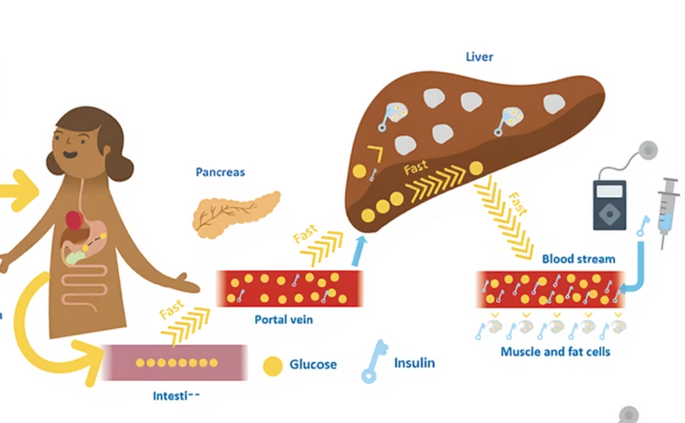
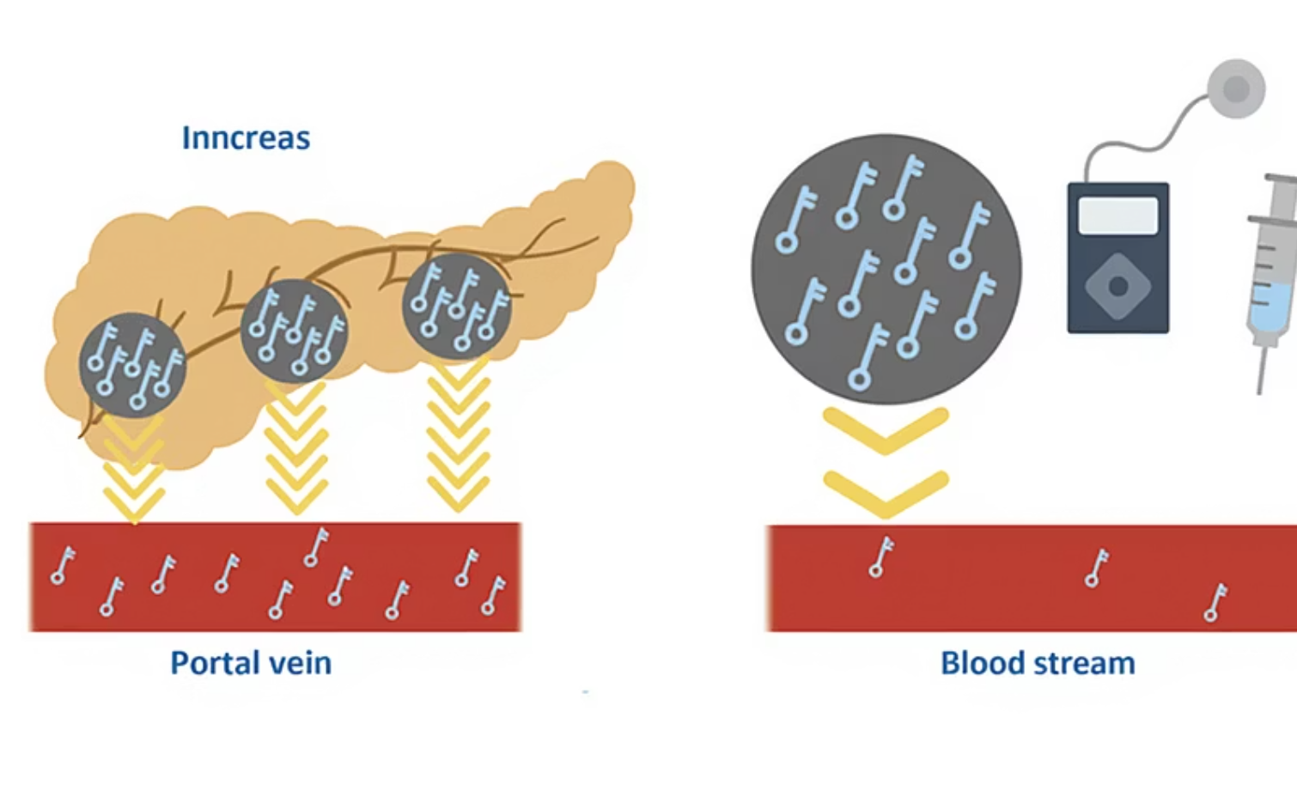
Type 1 Diabetes Insulin Challenges
Low portal vein insulin concentrations
Slow subcutaneous insulin absorption
References: Diabetic Med. 1998; (15): 972-978; Diabet Med. 2018;35(3):306–16; J Diabetes Sci Technol. 2017;11:753-8.; Diabetes Res Clin Pract. 2013;99:19-23

Slide 5
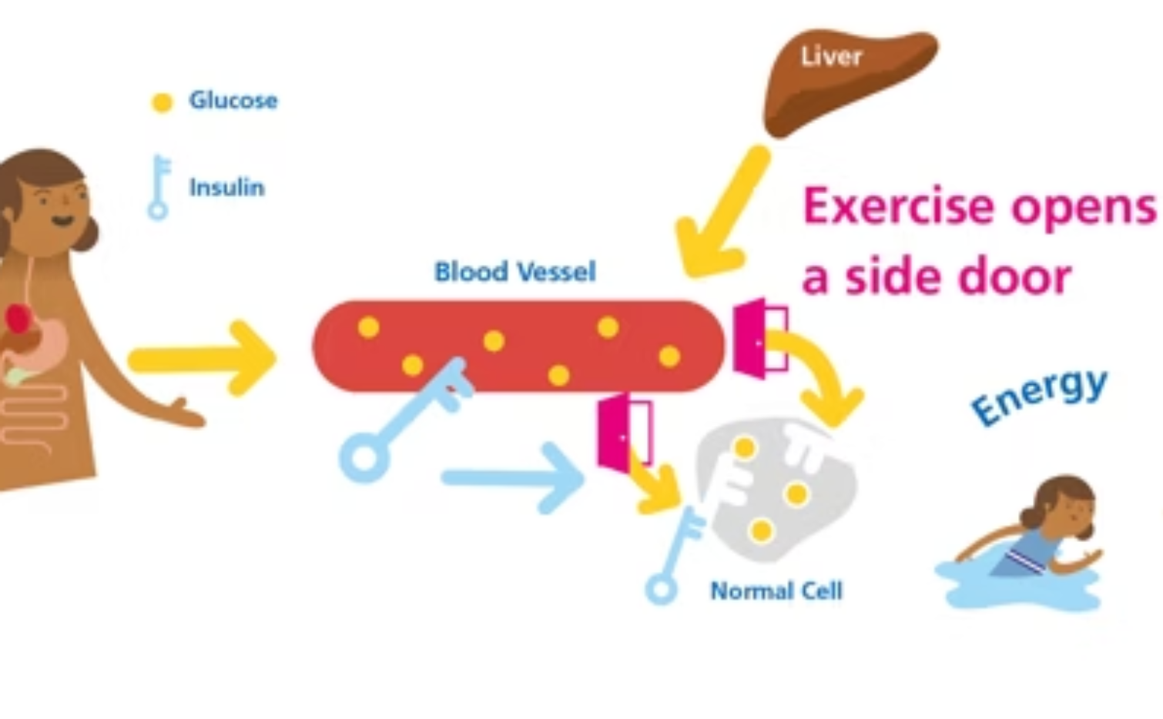
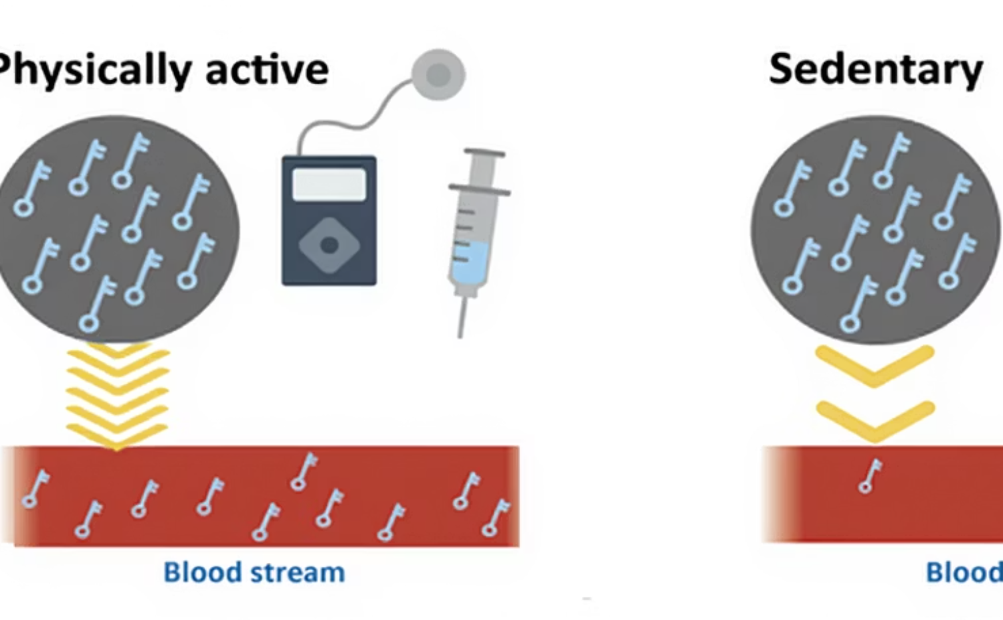
Physical Activity to the Rescue
Non-insulin Mediated Uptake
Faster Insulin Absorption
Diabetes Obesity & Metabolism (2024). https://doi.org/10.1111/dom.16088; Nat Rev Endocrinol. 2017 Mar 1;13(3):133–48.; Physiol Rev. 2015;95(2):549–601.

Slide 6
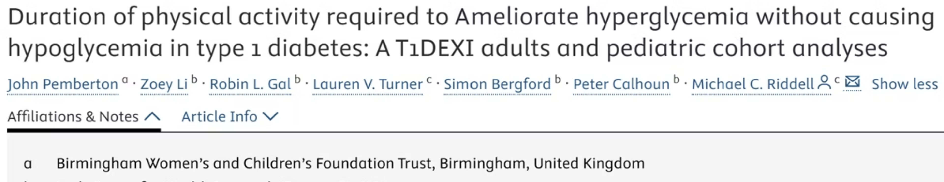

“But John… There’s No Control!”
Peter Calhoun: “It’s nice data, but John, there is no control. The glucose may have dropped without activity!”
John Pemberton: "I know a Data Scientist I can challenge to take on a matched pair analysis"
Catherine Russon: "Challenge accepted!"
Clin Pract. 2025 Feb;220:111981. doi: 10.1016/j.diabres.2024.111981

Slide 7
Study Overview: Aims, Criteria & Population
AIMS
INCLUSION CRITERIA
STUDY POPULATION
Assess glucose changes during physical activity in adults and adolescents with T1D using a pair-matching approach
Starting glucose >10.0 mmol/L (180 mg/dL)
T1DEXI: 561 adults
T1DEXIP: 225 adolescents
Self-reported activity: 10-30 min
CGM data available ≥70% for 1 hour before and 20 mins after

Slide 8
Study Overview
Data Acquired
1
T1DEXI: 561 adults (>10,000 bouts)
T1DEXIP: 225 adolescents (3,500+ bouts)
Total: 786 participants, >13,500 bouts
2
Eligibility Applied
CGM ≥70%
Insulin data
Exclusion
3
≥1 PA bout (10–30 min, start glucose >10 mmol/L)
Removed duplicate bouts and those lacking sufficient pre/post data points.
Result: 1,944 candidate bouts
Result: 1,546 activity bouts for matching.
4
Matched Pair Selection
Each activity bout matched with non-activity control periods.
Data Analysis
5
Result: Control bouts identified for all 1,546 data points
Causal modeling and mixed linear model applied.
Assessed glucose change during activity vs. control periods.
Identified individual and event-level moderators.

Slide 9
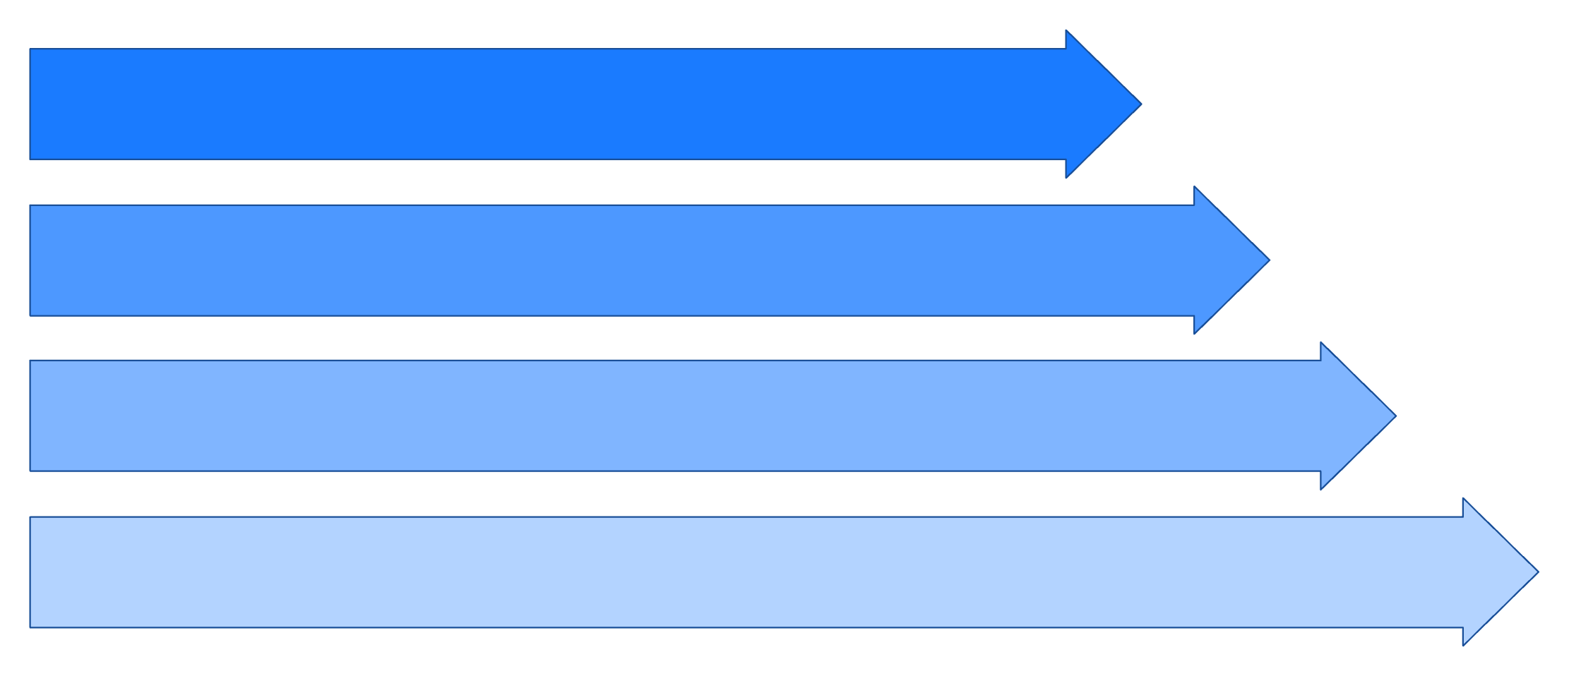


Hierarchal Variable Selection (Mixed Liner Model)
Within Participant Matching: Activity Day vs Matched No Activity Day
Starting Glucose
Glucose Rate of Change
Insulin on Board
Glucose co-efficient of Variation in 1-hour prior
Acceptable
Our Matched-Pair
Threshold
Analysis
SMD <0.1
SMD <0.01

Slide 10
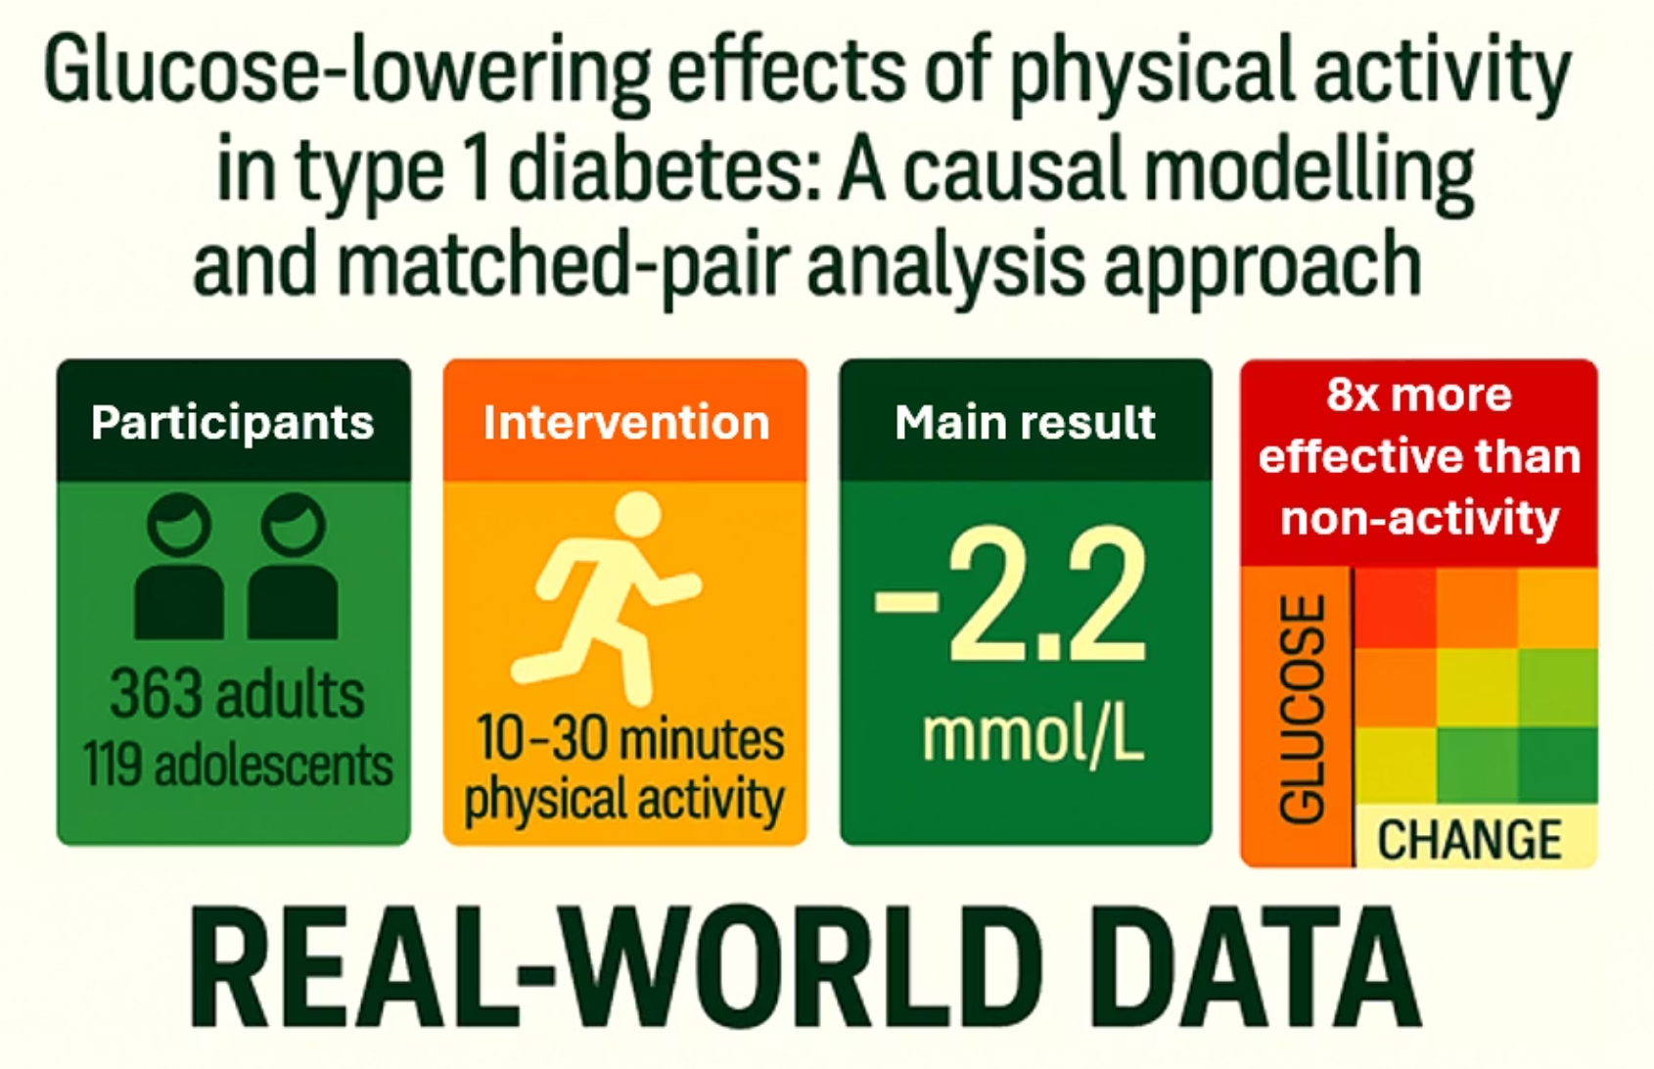
Main Results
PA [median 23 minutes: IQR (20, 30)]
Mean glucose change of -2.2 mmol/L (p<0.001)
Matched Non-PA Periods
Mean glucose change of 0.3 mmol/L (p<0.001)
Mean Difference
-1.9 mmol/L (p<0.0001)
No Significant Differences
By age, gender, activity type, intensity
Hypoglycaemia
Less than 2%

Slide 11
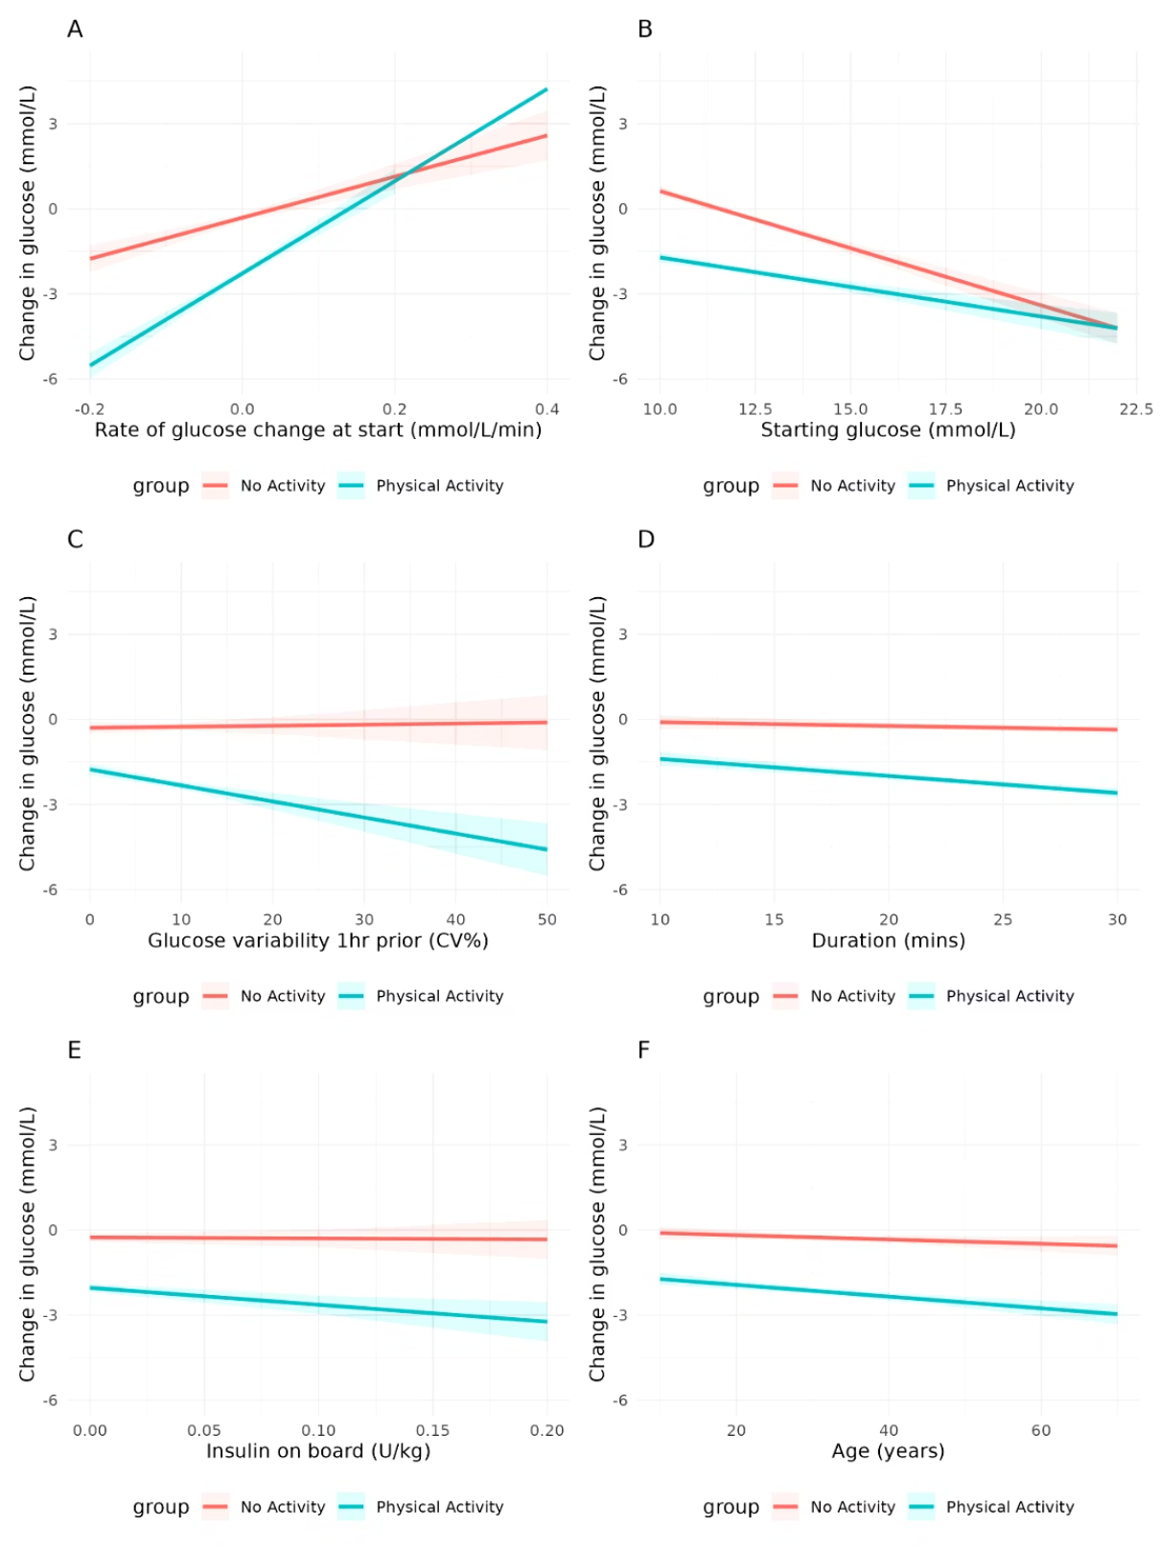
Individual- and Event-Level Moderators of the Differential Glucose Drop Between Physical Activity and Non-PA
Legend: This figure displays individual- and event-level factors that influenced the difference in glucose change between physical activity (PA) and matched non-PA periods:
(A) starting glucose rate of change
(B) starting glucose level
(C) Pre-PA (1-hour) glucose coefficient of variation (CV) (D) Activity duration
(E) starting insulin on board (IOB)
(F) Age

Slide 12
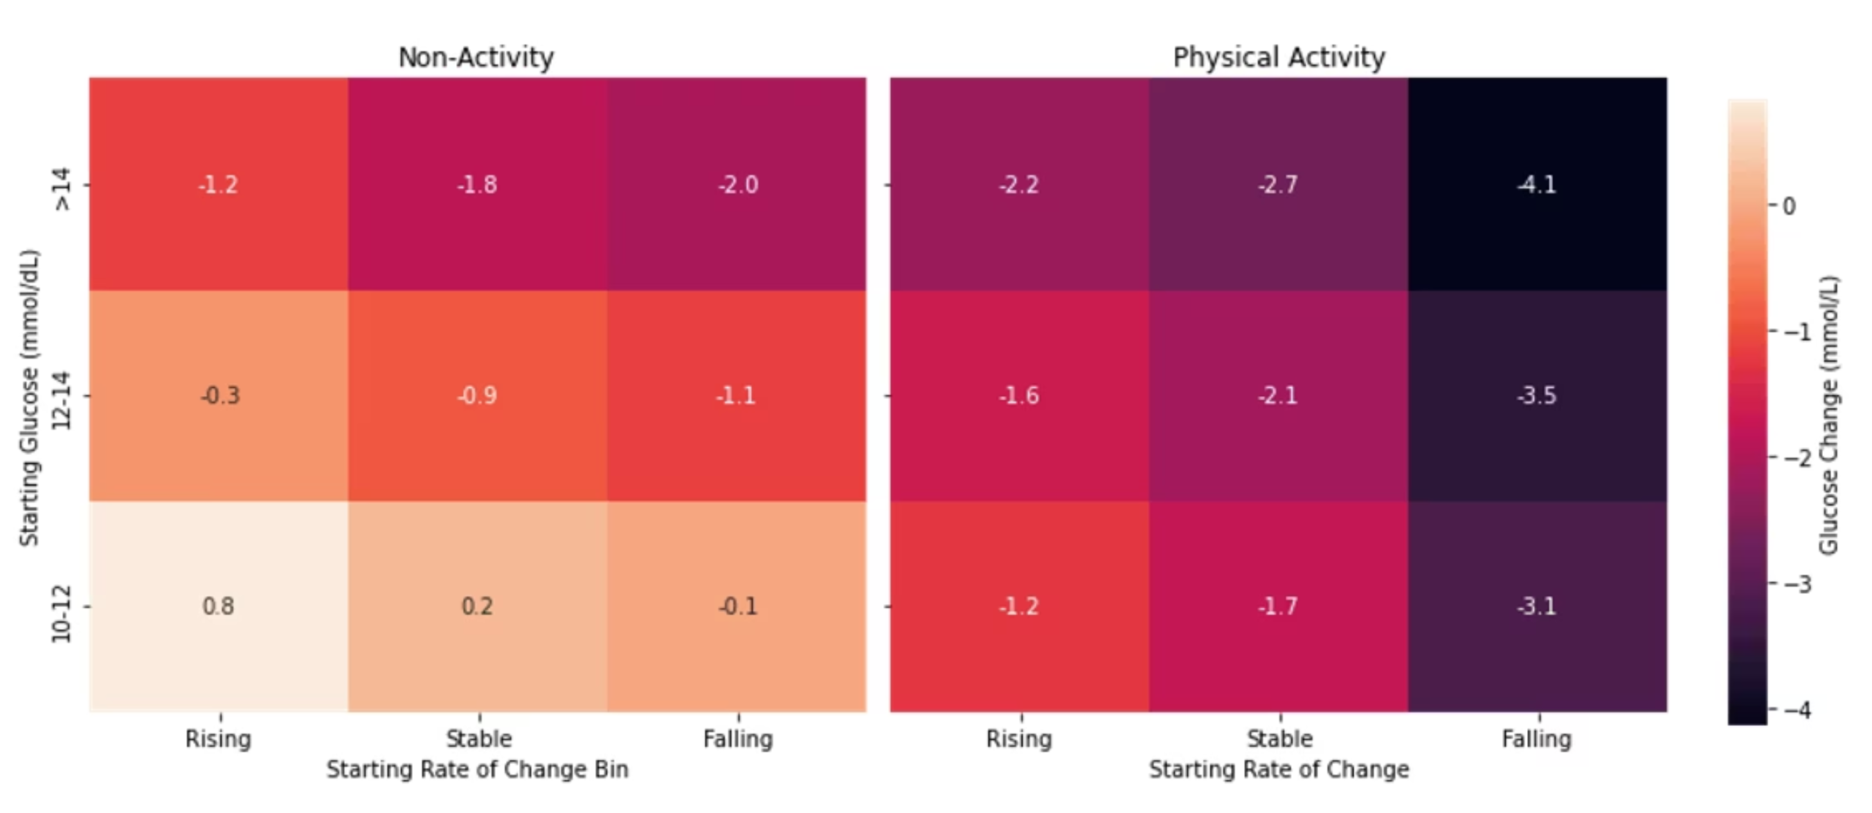
Predicted Glucose Trajectories Based on Physical Activity Status, Starting Glucose, and Glucose Rate of Change (mmol/L)

Slide 13
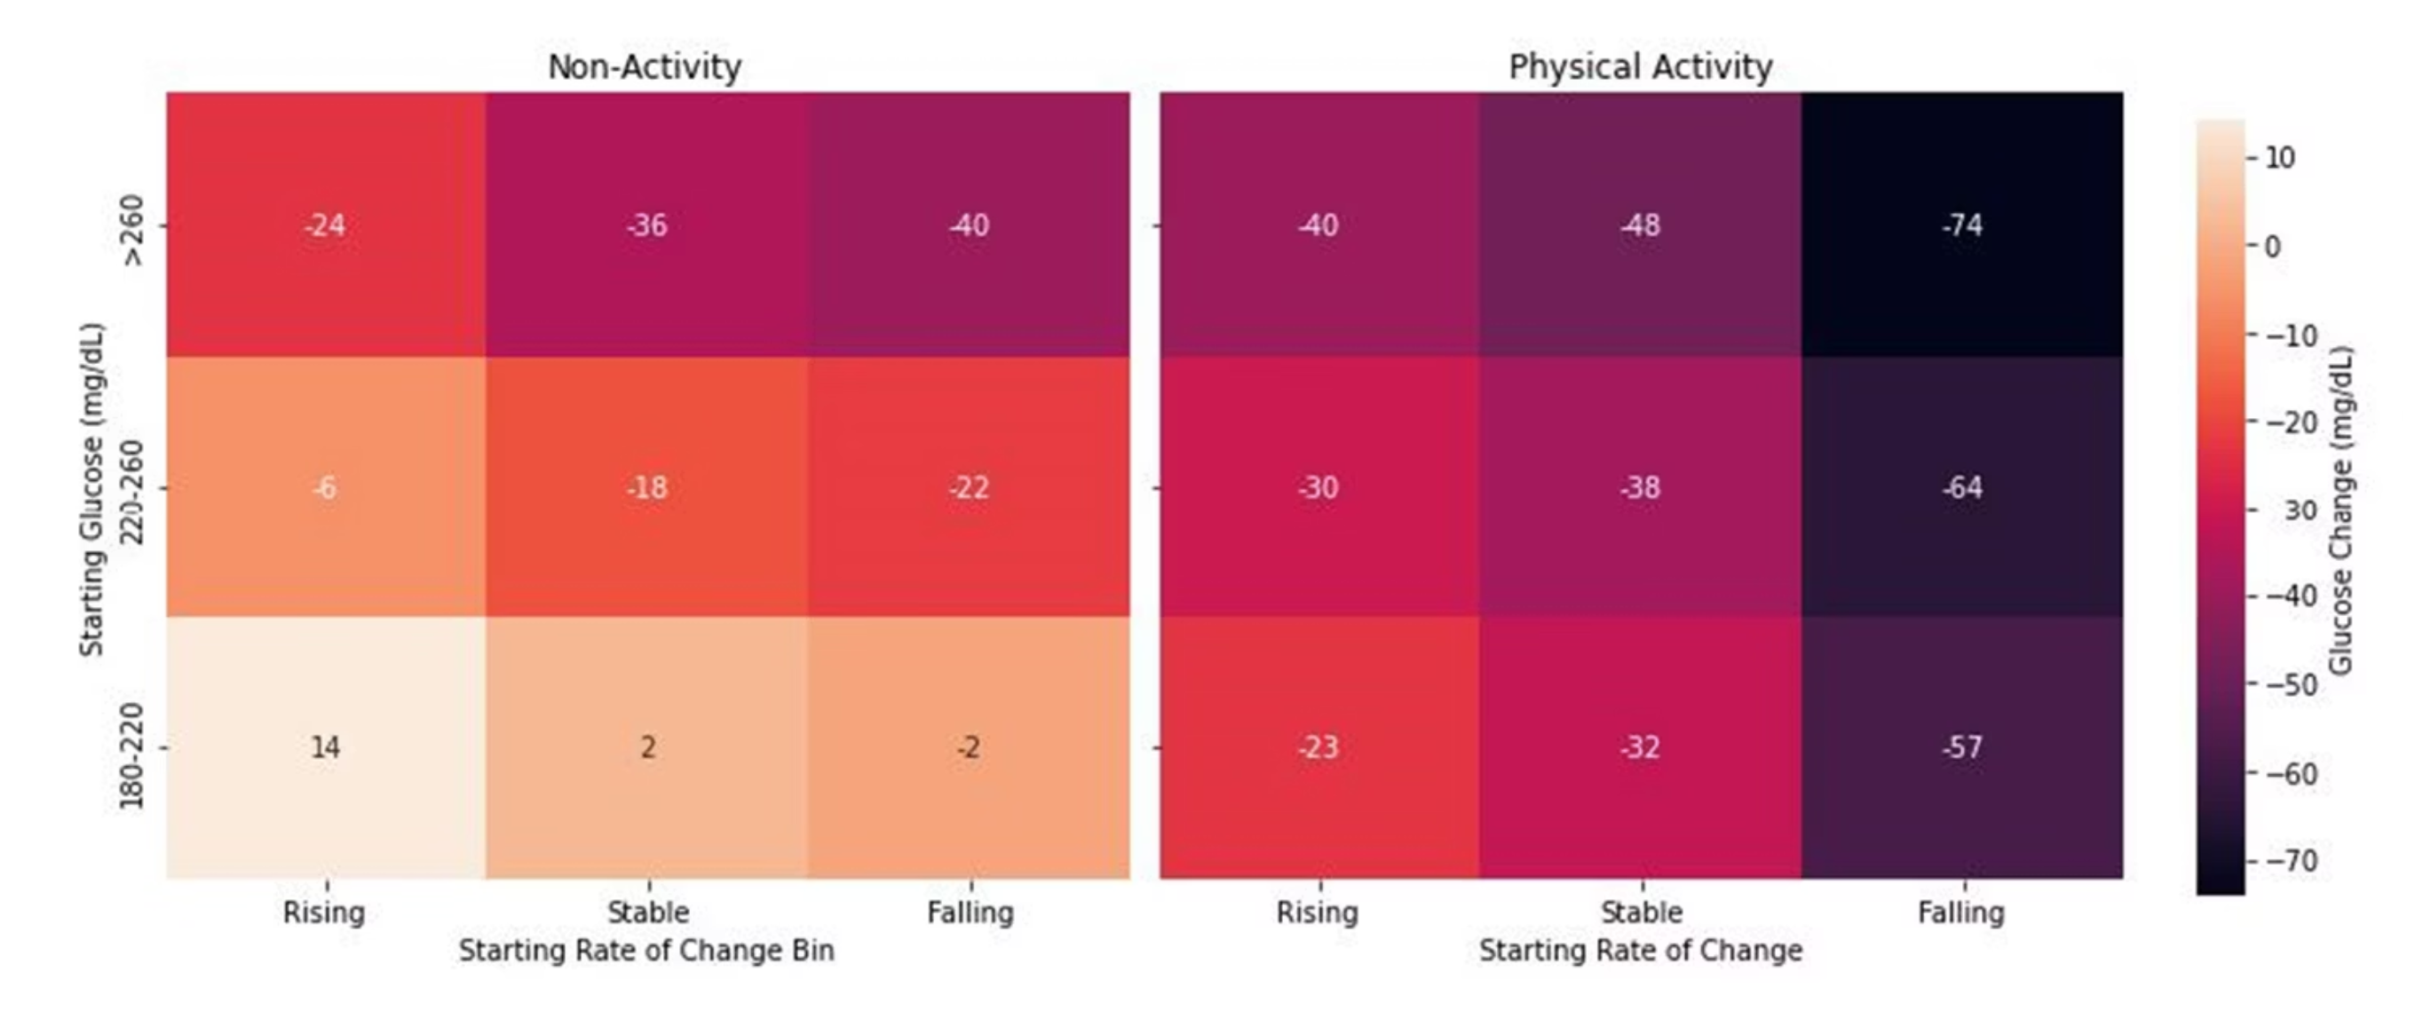
Predicted Glucose Trajectories Based on Physical Activity Status, Starting Glucose, and Glucose Rate of Change (mg/dL)

Slide 14
Strengths and Limitations
Strengths
Limitations
High Ecological Validity
Unable to Differentiate
large sample size across wide age range
Intensities of anerobic were low (heart rate)
Rigorous Pair-Matching
Activity Bouts
Approach controlling for multiple predictors of glucose change
Were of limited duration 10-30 mins
Consistency Across Cohorts
Short Observation Period
Findings replicated across all ages
20-min post activity
Data Capture
Study Population Bias
CGM and pump Uploads
Mainly white ethnicity and private health insurance

Slide 15
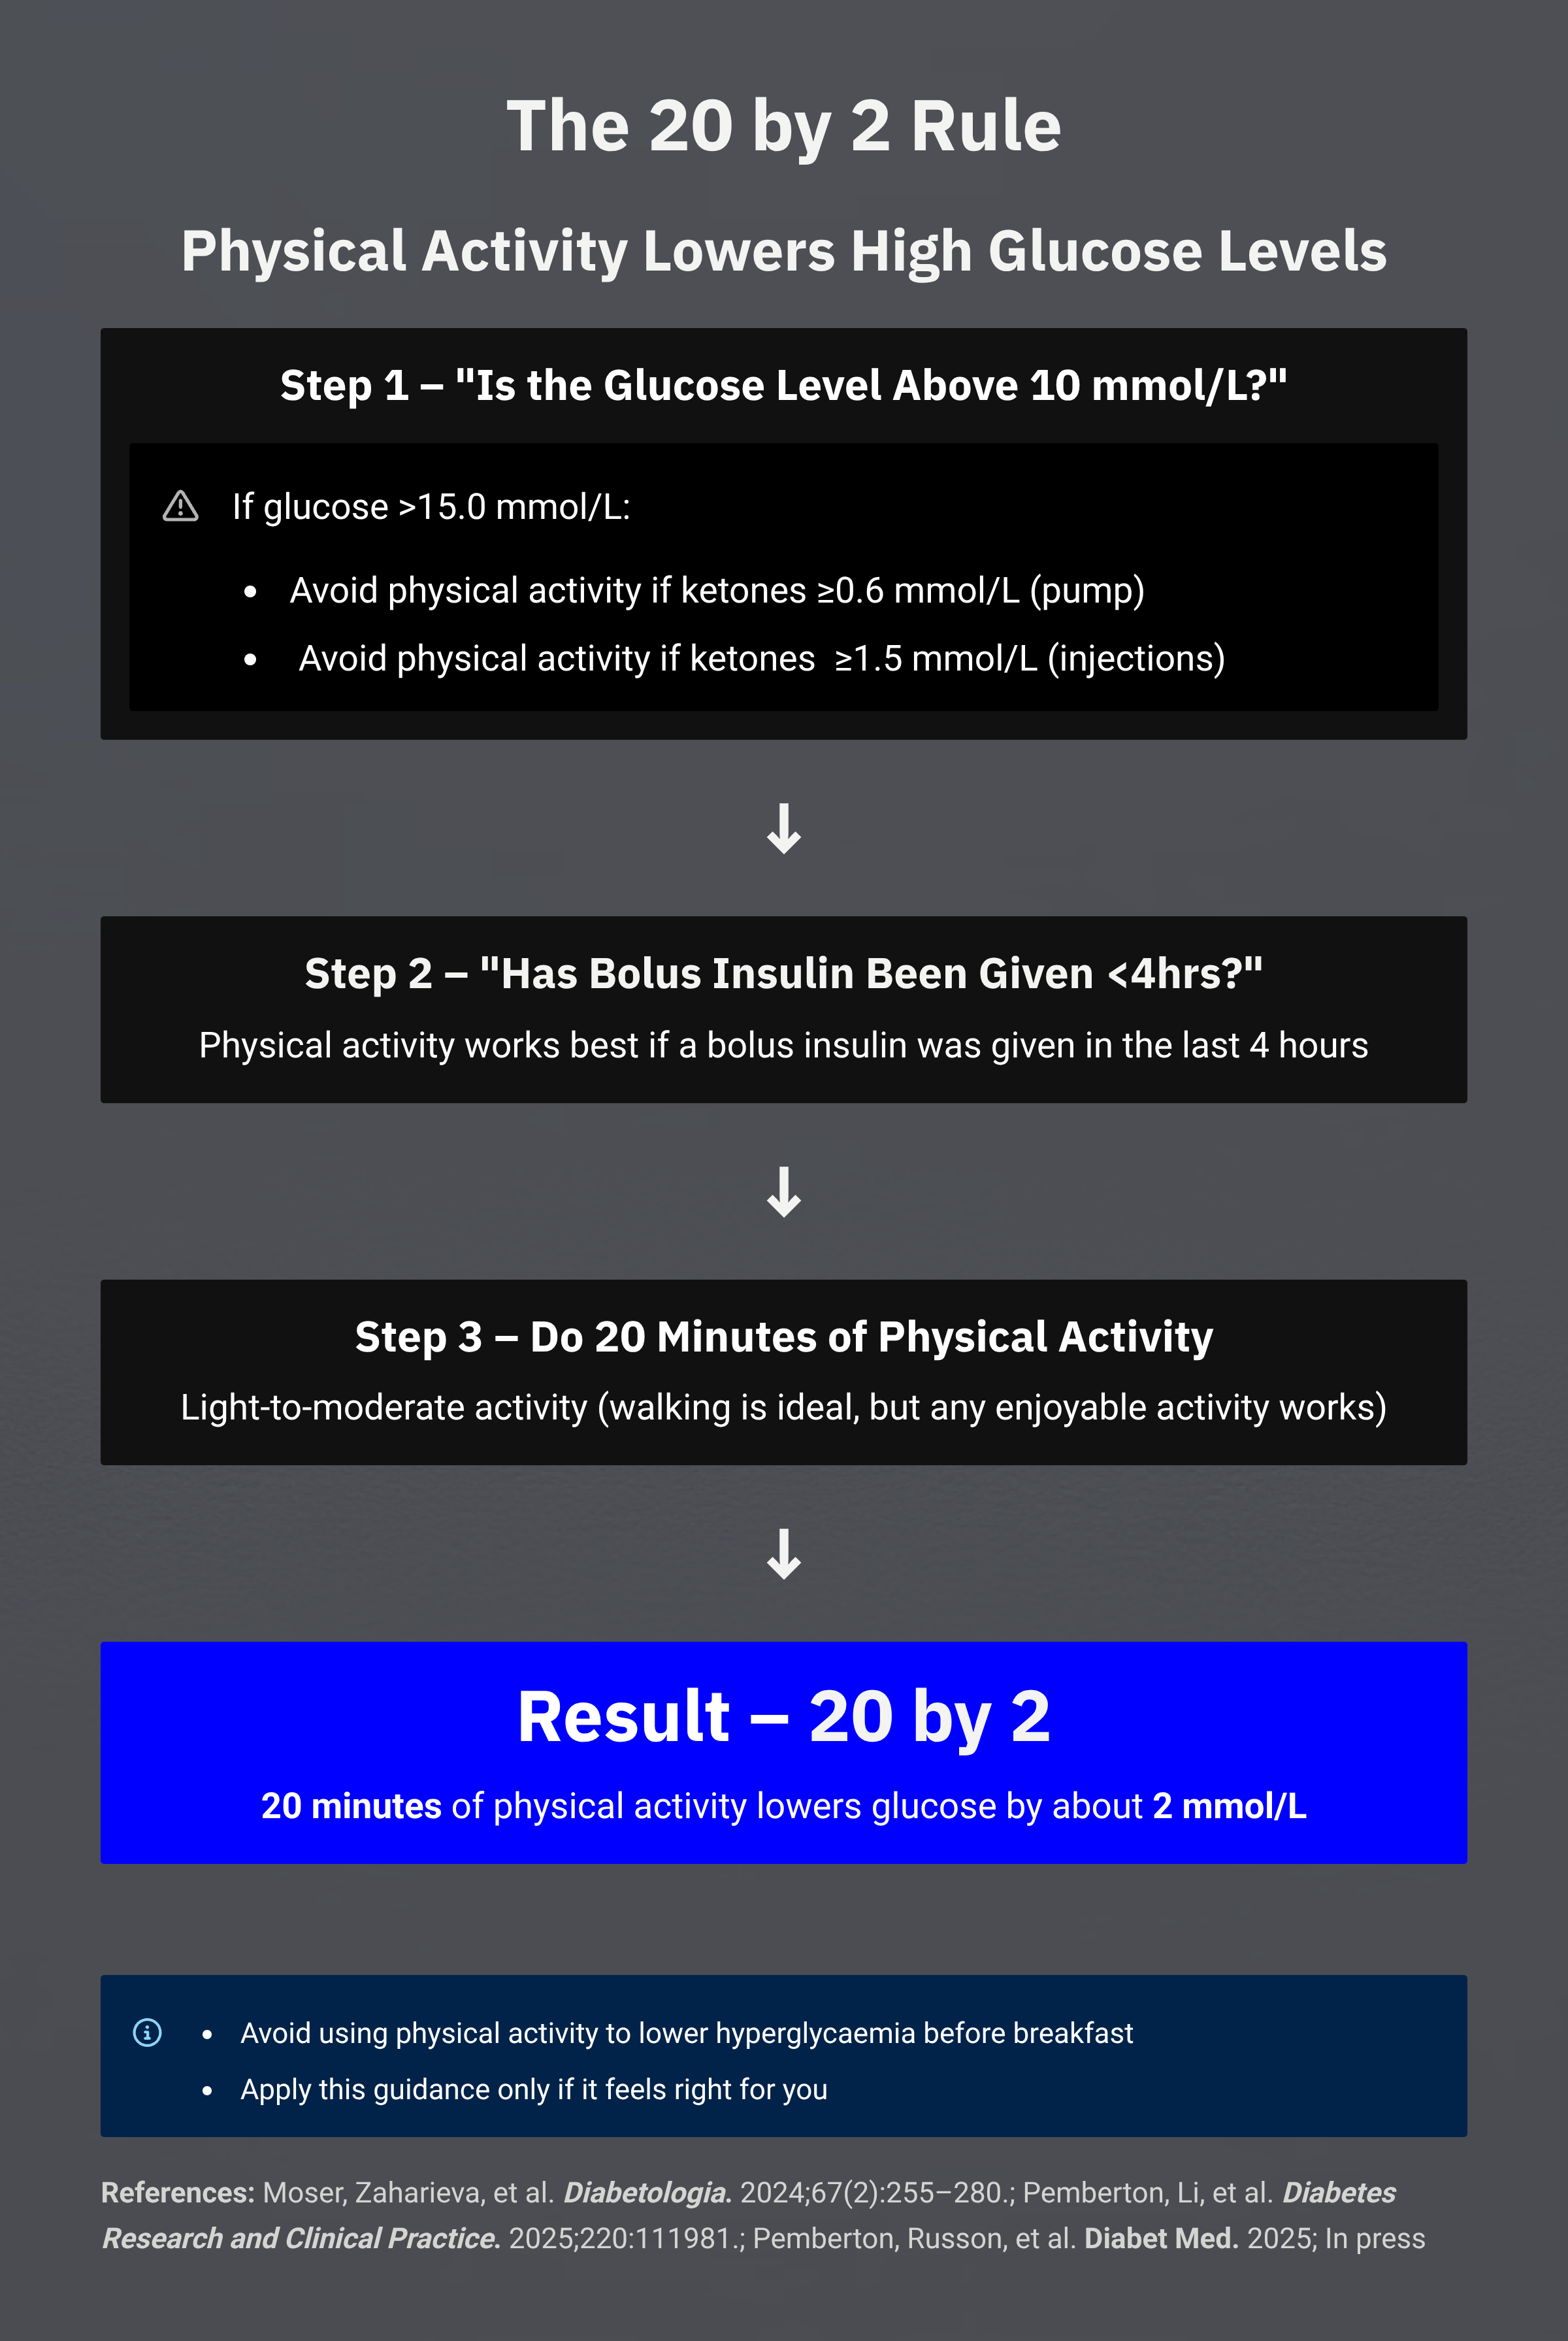



Slide 16




Acknowledgements
North American Research Team
Zoey Li
Robin L. Gal
Lauren V. Turner
Simon Bergford
Peter Calhoun
“99 Problems
But High Glucose Ain’t One”
Michael C. Riddell
UK Research Team
Cat Russon
Richard Pulsford
Brad Metcalf
Emma Cockcroft
Michael Allen
Anne-Marie Frohock
Rob Andrews
Special thanks to Chad, my ChatGPT AI Assistant, for polishing and refining my work. The insights and responsibility remain mine — Chad simply helps make the content more enjoyable to follow.

