Slide 1

A Paradigm Shift
Using CGM to Dose Physical Activity
to Optimize Time in Range
John Pemberton RD, Birmingham Children’s Hospital

Slide 2
 | No, Nothing to disclose
Y | Yes, please specify disclosures
Company / Name | Honoraria / Expense | Consulting / Advisory Board | Funded Research | Royalties / Patent | Stock Options | Ownership / Equity Position | Employee | Other (Please specify)
ROCHE | Y | Y
Dexcom | Y
Insulet | Y
Abbott | Y | Y

Slide 3
Agenda
Physical activity recommendations and barriers
How close do current therapies get to achieving glucose targets?
Paradigm Shift: Using physical activity to optimize time in range

Slide 4
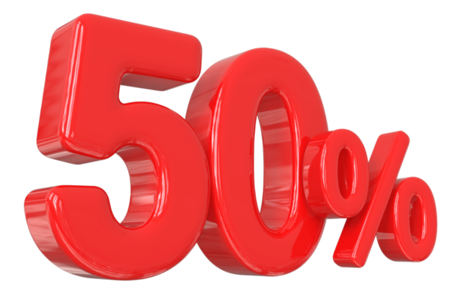
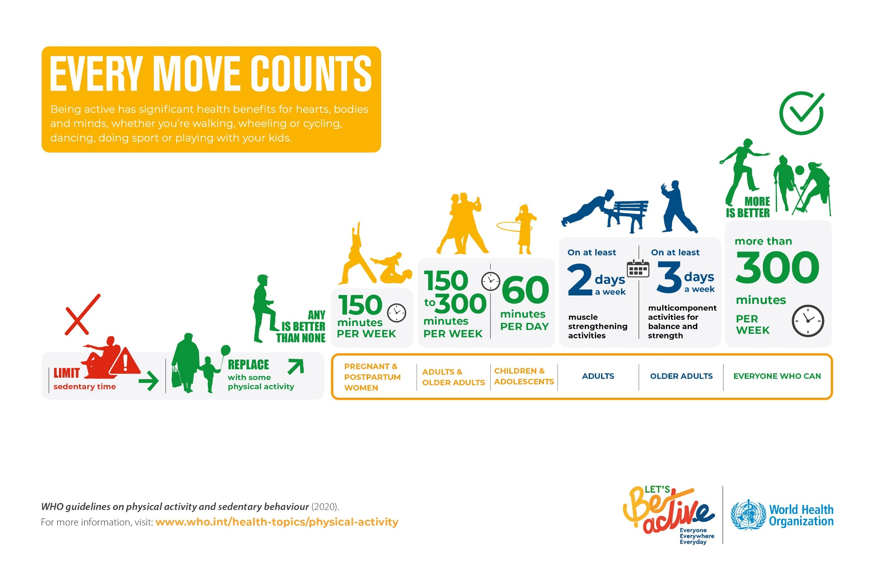
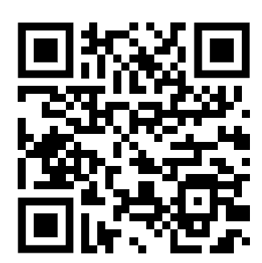
World Health Organisation
Br J Sports Med. 2020;54:1451-62

Slide 5

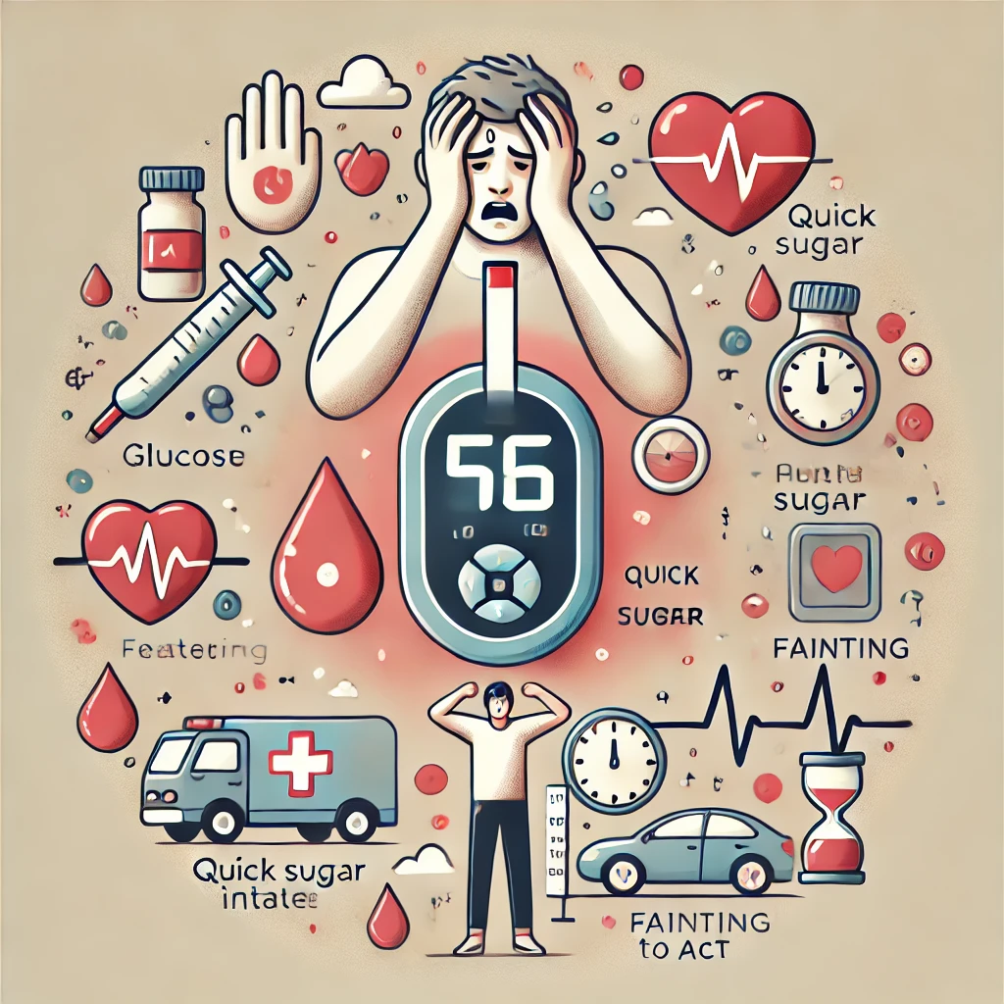
Barriers to Physical Activity
Appl Physiol Nutr Metab. 2021;46:95-107.
Canadian journal of diabetes. 2024;48:105-11.e5.
Canadian journal of diabetes. 2024.
PLoS One. 2014;9:e108019.
Canadian journal of diabetes. 2024;48:401-8.
Canadian journal of diabetes. 2023;47:124-32.
Diabetic medicine : 2024;41:e15149.
OpenAI. (2025). ChatGPT. https://chat.openai.com/chat
BMC Public Health 22, 1964 (2022).
https://doi.org/10.1186/s12889-022-14385-1
OpenAI. (2025). ChatGPT. https://chat.openai.com/chat

Slide 6
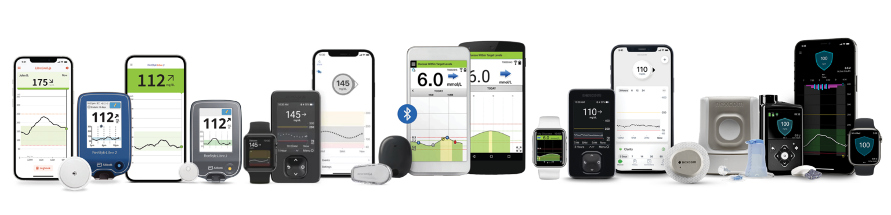
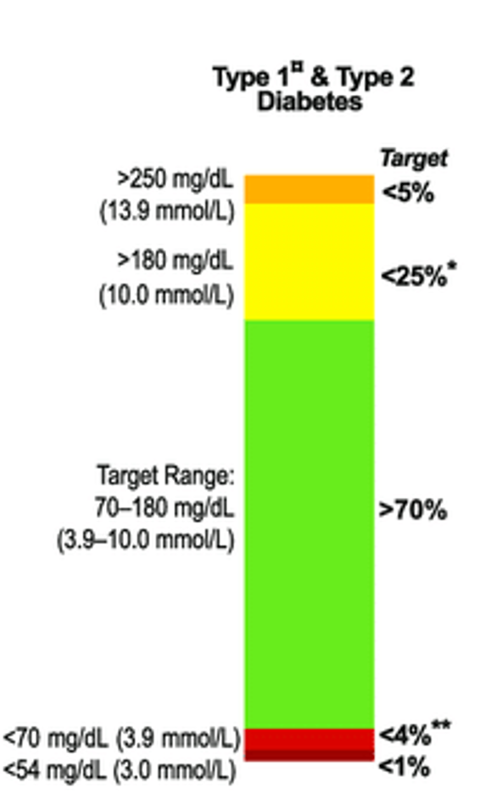
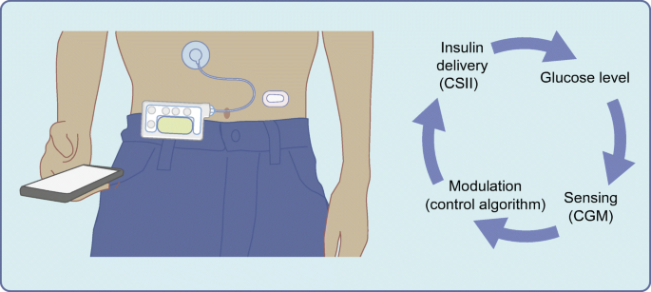
How many people with
T1D achieve 70% TIR?
Real world data 20-36% JAMANetworkOpen.2023;6(2):e230077.
doi:10.1001/jamanetworkopen.2023.0077
Real world data < 50%
BMC Med . 2024 Apr 24;22(1):175. doi: 10.1186/s12916-024-03396-x.
Diabetes Care. 2023 Oct 1;46(10):1831-1838.
Diabetes Care. 2019 Aug;42(8):1593-1603.
Diabetes care. 2024;47:S111-s25.
Pediatr Diabetes. 2022;23:1270-6.

Slide 7
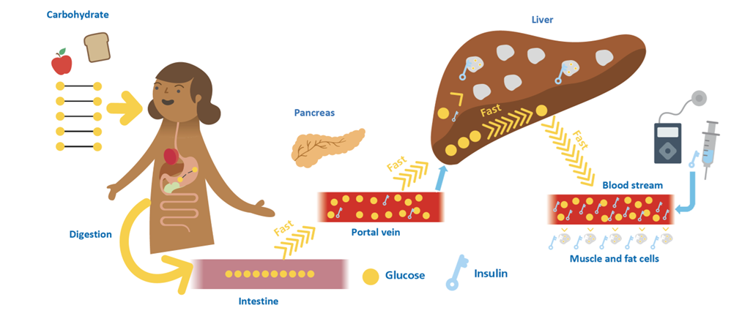
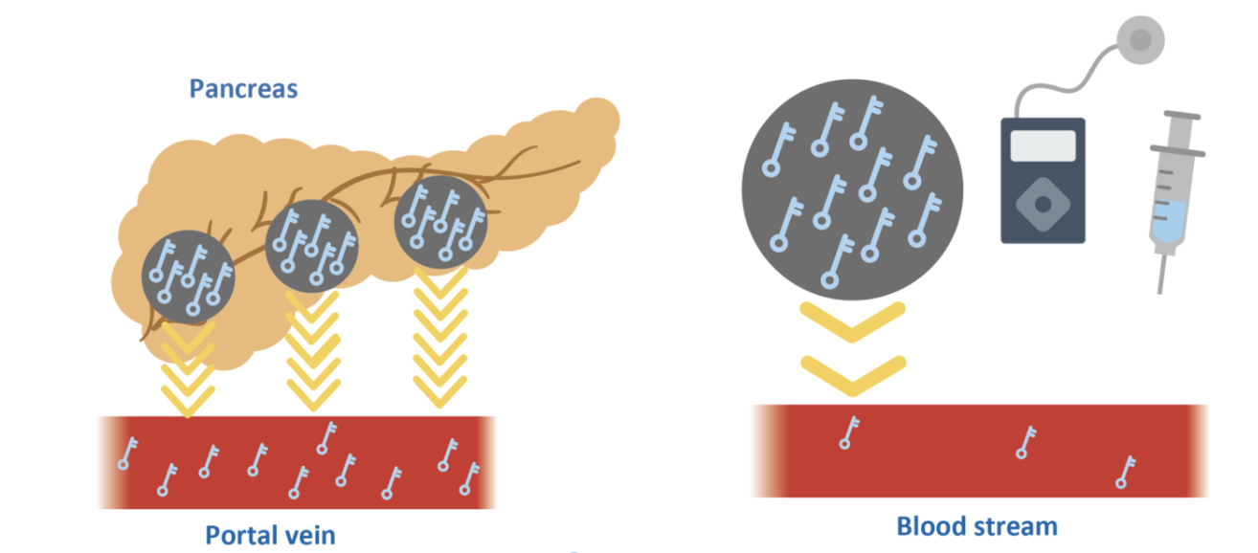

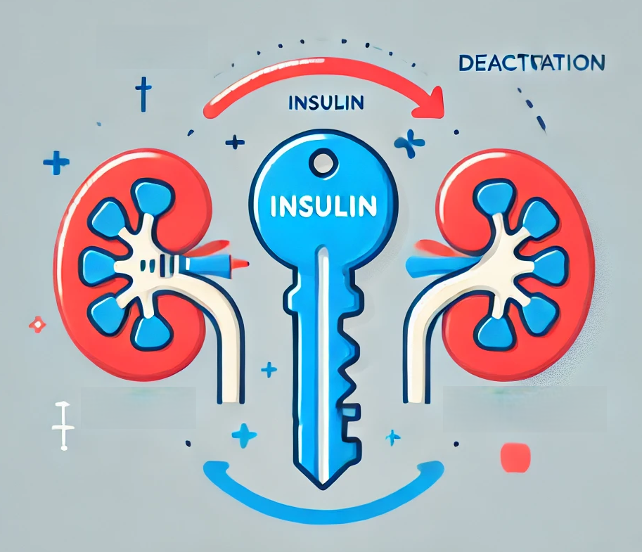
Challenges
Graphics courtesy of:
  Diabetic Med. 1998; (15): 972-978; Diabet Med. 2018;35(3):306–16; J Diabetes Sci Technol. 2017;11:753-8.; Diabetes Res Clin Pract. 2013;99:19-23;

Slide 8
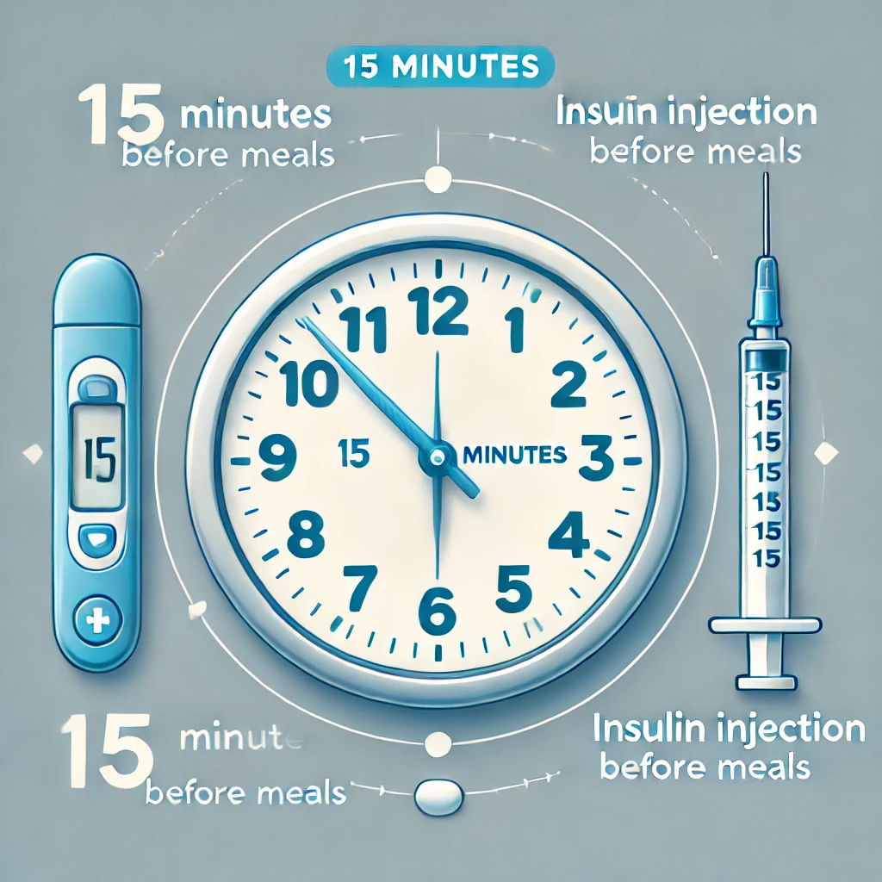
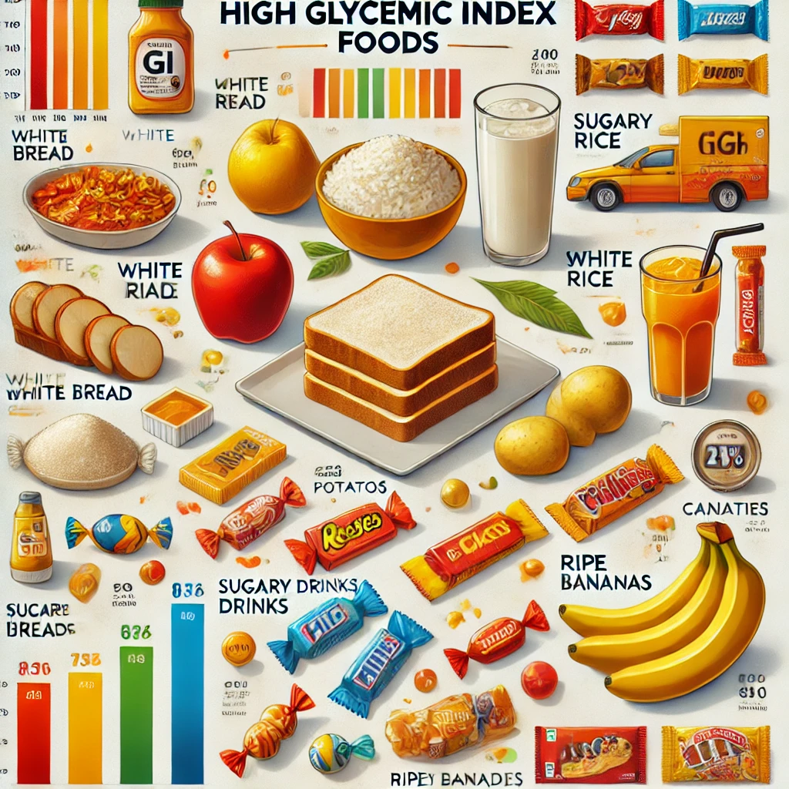
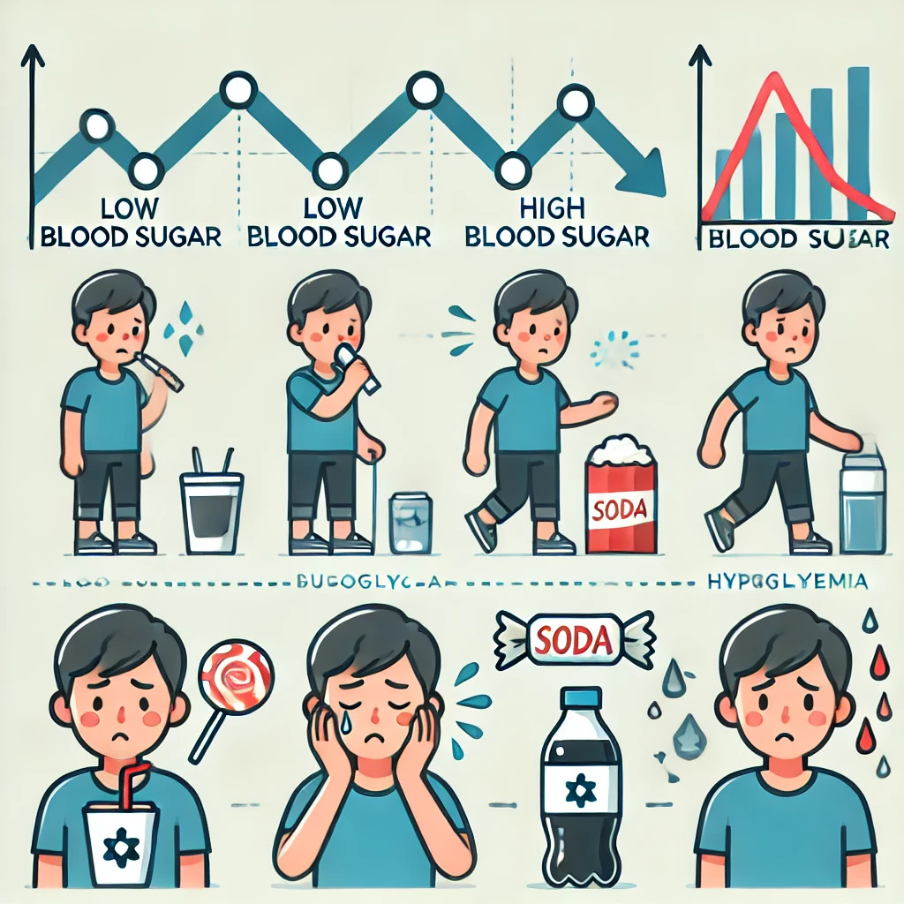
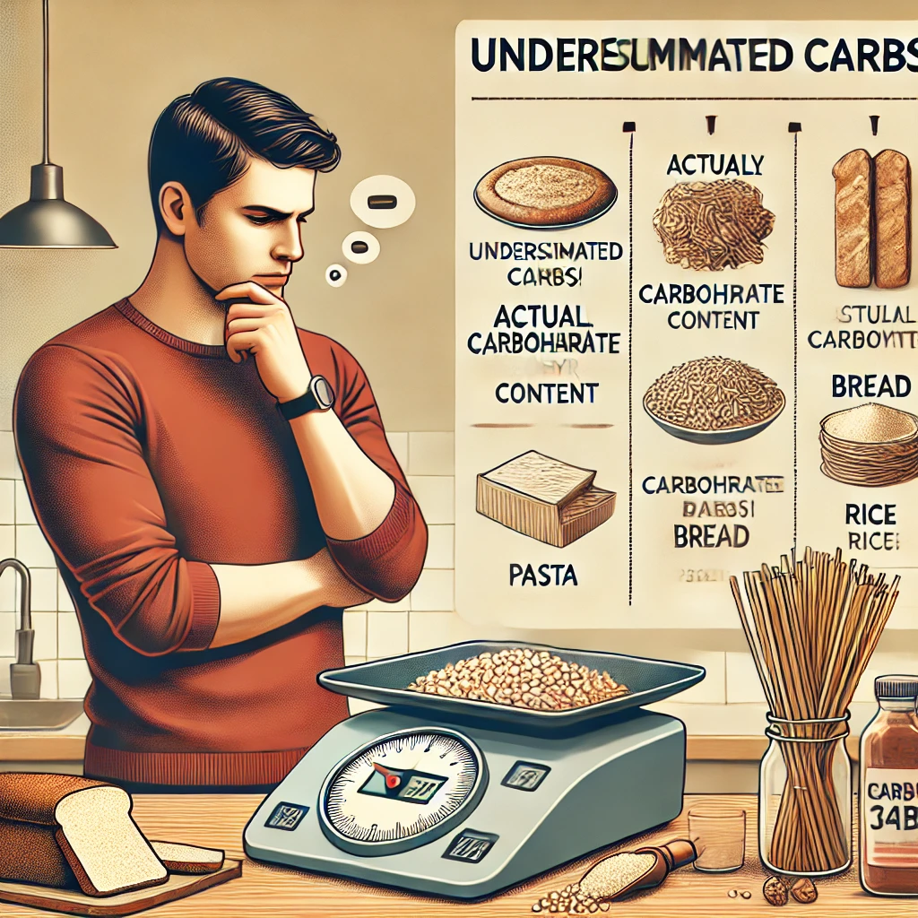
Challenges
  Diabetic Med. 1998; (15): 972-978; Diabet Med. 2018;35(3):306–16; J Diabetes Sci Technol. 2017;11:753-8.; Diabetes Res Clin Pract. 2013;99:19-23; OpenAI. (2025). ChatGPT. https://chat.openai.com/chat

Slide 9
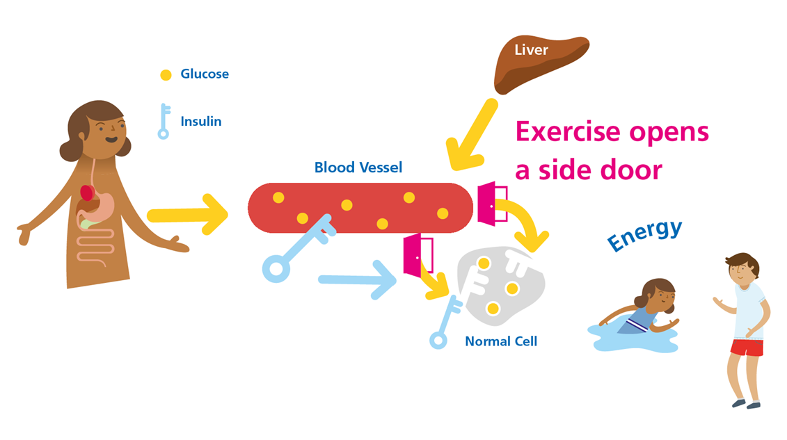
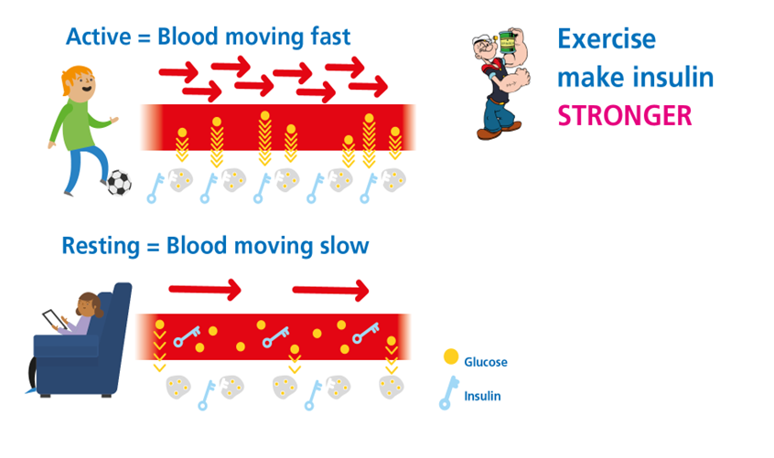
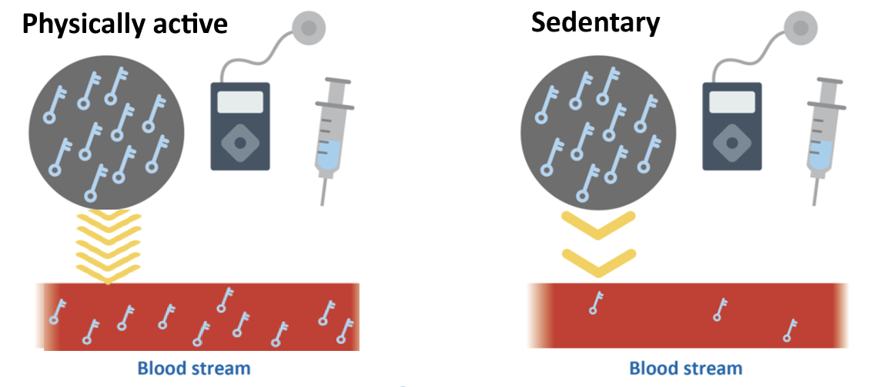
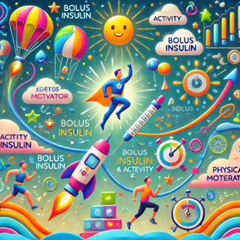
a
Physical activity can tackle physiologic
& behavioural challenges by Supercharging Insulin
Graphics courtesy of:
  Diabetes Obesity & Metabolism (2024). https://doi.org/10.1111/dom.16088; Nat Rev Endocrinol. 2017 Mar 1;13(3):133–48.; Physiol Rev. 2015;95(2):549–601.

Slide 10
What we already know?
Walking for 30-minutes after meals stops hyperglycaemia for T1D and non-T1D
  Diabetes Care 35:2493–2499, 2012
Lauren Turner: Walking for 20-minutes before meals improves post-meal glucose
  Diabetes Obes Metab. 2024;26:2492–2496
3 every 30:
  3 minutes of walking every 30 minutes improves 24hr time in range by ~14%
  Diabetes Obes Metab. 2023 Dec;25(12):3589-3598. doi: 10.1111/dom.15254
All with minimal impact on hypoglycaemia risk
But what if the glucose is already above 180 mg/dL (10 mmol/L)?

Slide 11
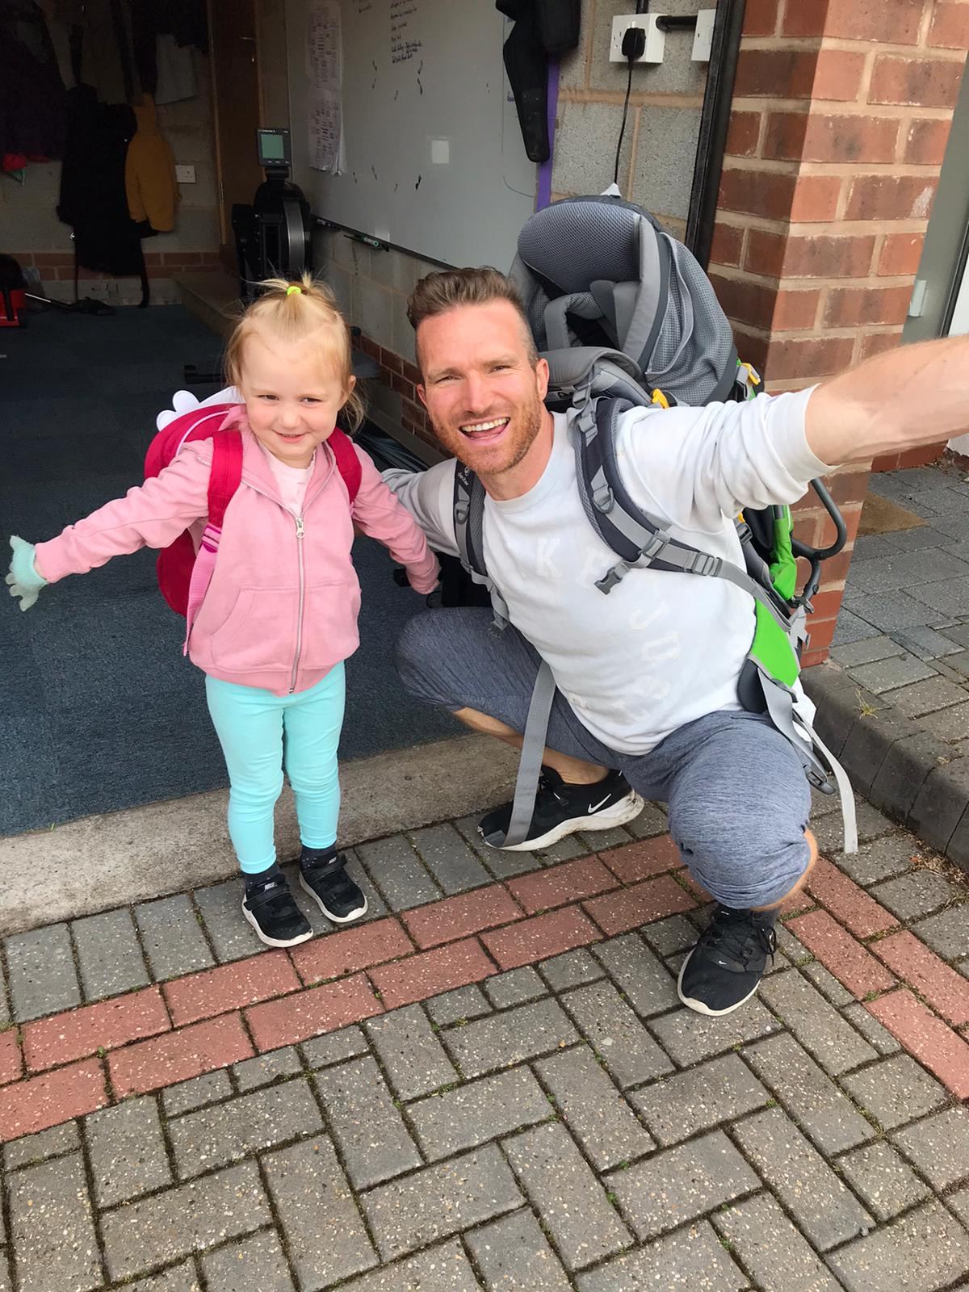
N = 1
Riddell et al., Paediat Diabetes 2019; 20(1): 99-106
Notes:
Objective: To evaluate the pattern of change in blood glucose concentrations and hypoglycemia
risk in response to prolonged aerobic exercise in adolescents with type 1 diabetes (T1D) that
had a wide range in pre-exercise blood glucose concentrations.
Methods: Individual blood glucose responses to prolonged (~60 minutes) moderate-intensity
exercise were profiled in 120 youth with T1D.
Results: The mean pre-exercise blood glucose concentration was 178 66 mg/dL, ranging
from 69 to 396 mg/dL, while the mean change in glucose during exercise was −76 55 mg/dL
(mean SD), ranging from +83 to −257 mg/dL. Only 4 of 120 youth (3%) had stable glucose
levels during exercise (ie, ≤10 mg/dL), while 4 (3%) had a rise in glucose >10 mg/dL, and the
remaining (93%) had a clinically significant drop (ie, >10 mg/dL). A total of 53 youth (44%) developed
hypoglycemia (≤70 mg/dL) during exercise. The change in glucose was negatively correlated
with the pre-exercise glucose concentration (R2 = 0.44, P < 0.001), and tended to be
greater in those on multiple daily insulin injections (MDI) vs continuous subcutaneous insulin
infusion (CSII) (−98 15 vs −65 7 mg/dL, P = 0.05). No other collected variables appeared
to predict the change in glucose including age, weight, height, body mass index, disease duration,
daily insulin dose, HbA1c, or sex.
Conclusion: Youth with T1D have variable glycemic responses to prolonged aerobic exercise,
but this variability is partially explained by their pre-exercise blood glucose levels. When no
implementation strategies are in place to limit the drop in glycemia, the incidence of exerciseassociated
hypoglycemia is ~44% and having a high pre-exercise blood glucose concentration is
only marginally protective.

Slide 12
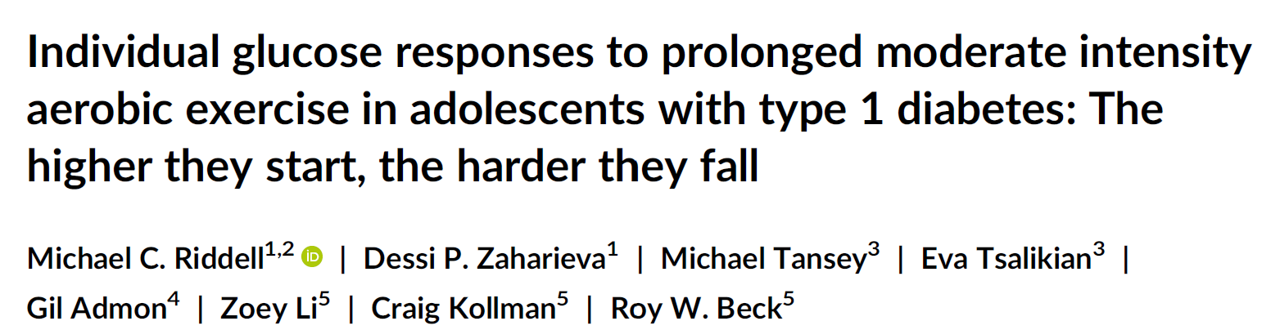
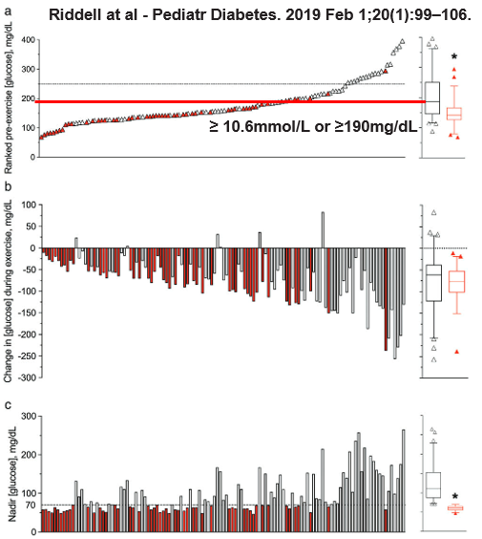
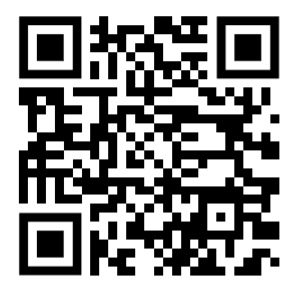
45 minutes drops by:
110 mg/dL or 6.1 mmol/L
15 minutes drops by:
~40 mg/dL or ~2 mmol/L
~75% vs <10% hypoglycaemia
44% hypoglycaemia
Riddell et al., Paediat Diabetes 2019; 20(1): 99-106
Notes:
Objective: To evaluate the pattern of change in blood glucose concentrations and hypoglycemia
risk in response to prolonged aerobic exercise in adolescents with type 1 diabetes (T1D) that
had a wide range in pre-exercise blood glucose concentrations.
Methods: Individual blood glucose responses to prolonged (~60 minutes) moderate-intensity
exercise were profiled in 120 youth with T1D.
Results: The mean pre-exercise blood glucose concentration was 178 66 mg/dL, ranging
from 69 to 396 mg/dL, while the mean change in glucose during exercise was −76 55 mg/dL
(mean SD), ranging from +83 to −257 mg/dL. Only 4 of 120 youth (3%) had stable glucose
levels during exercise (ie, ≤10 mg/dL), while 4 (3%) had a rise in glucose >10 mg/dL, and the
remaining (93%) had a clinically significant drop (ie, >10 mg/dL). A total of 53 youth (44%) developed
hypoglycemia (≤70 mg/dL) during exercise. The change in glucose was negatively correlated
with the pre-exercise glucose concentration (R2 = 0.44, P < 0.001), and tended to be
greater in those on multiple daily insulin injections (MDI) vs continuous subcutaneous insulin
infusion (CSII) (−98 15 vs −65 7 mg/dL, P = 0.05). No other collected variables appeared
to predict the change in glucose including age, weight, height, body mass index, disease duration,
daily insulin dose, HbA1c, or sex.
Conclusion: Youth with T1D have variable glycemic responses to prolonged aerobic exercise,
but this variability is partially explained by their pre-exercise blood glucose levels. When no
implementation strategies are in place to limit the drop in glycemia, the incidence of exerciseassociated
hypoglycemia is ~44% and having a high pre-exercise blood glucose concentration is
only marginally protective.

Slide 13
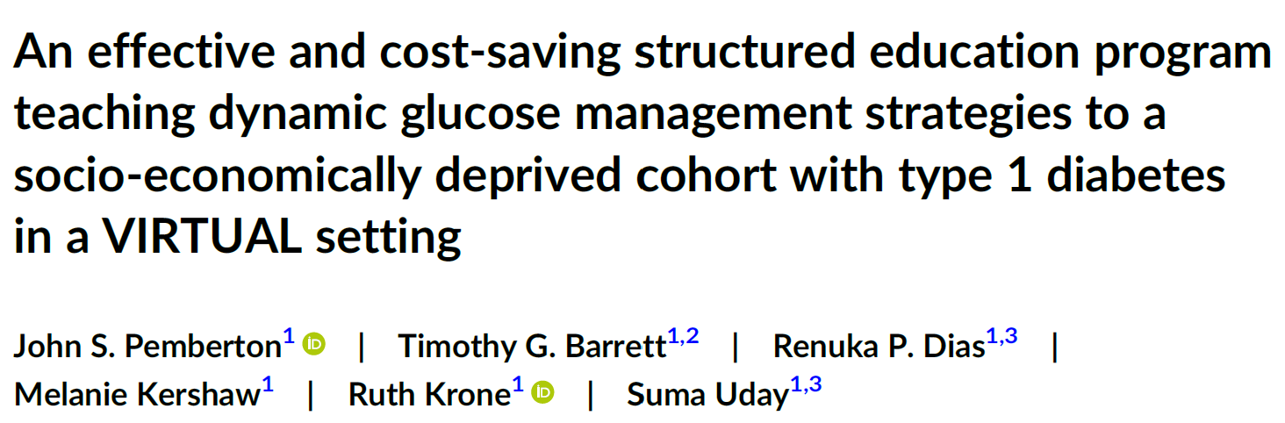

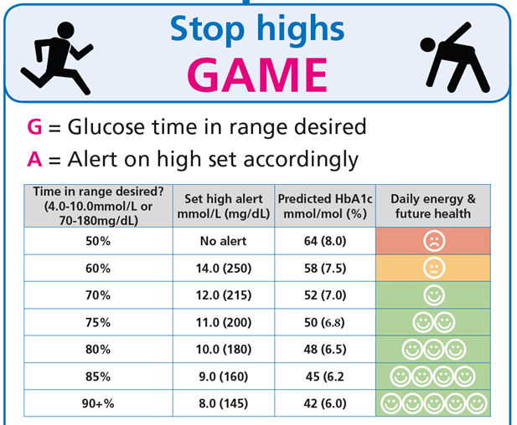
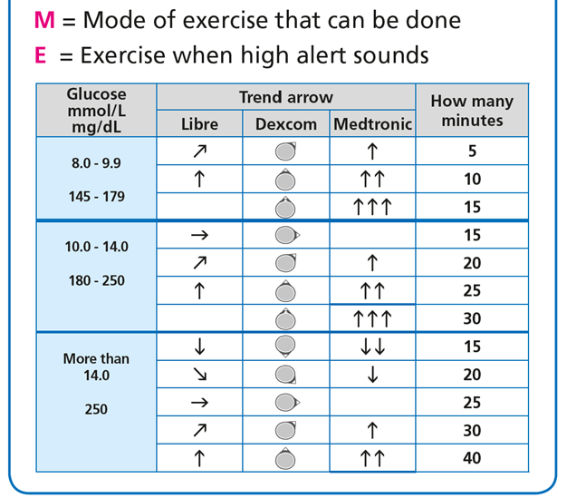
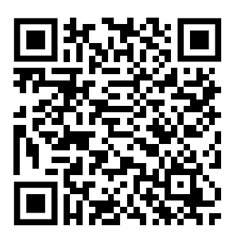
15 mins drops glucose by
~2.0 mmol/L (40 mg/dL)
Pediatr Diabetes. 2022;23(7):1045-1056.

Slide 14
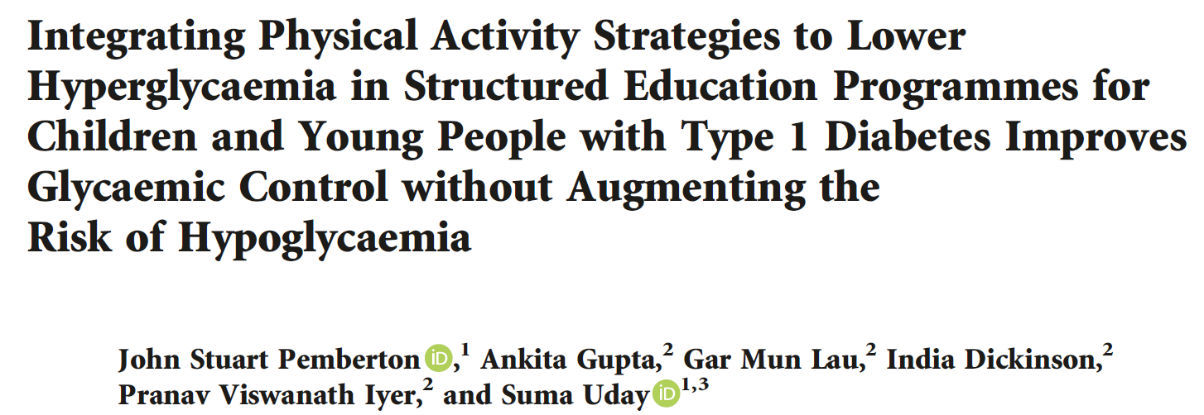
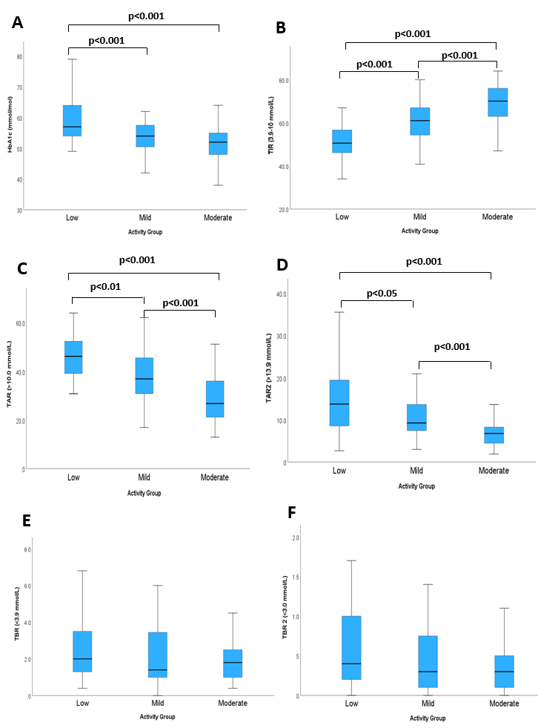
TIR (3.9-10.0 mmol/L)
HbA1c (mmol/L)
125 paediatrics: Use of GAME?
Low (30%)
Mild (34%)
Moderate (36%)
No difference in HbA1c at baseline
TAR2 (>13.9 mmol/L)
TAR (>10.0 mmol/L)
TBR (<3.9 mmol/L)
TBR2 (<3.0mmol/L)
Limitations:
Self-report
Intensity not verified
Association not causation
Pediatr Diabetes. 2023 Article ID 2519368. https://doi.org/10.1155/2023/2519368

Slide 15
N = 120

Slide 16
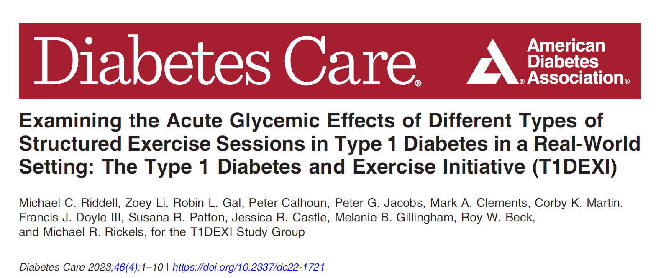
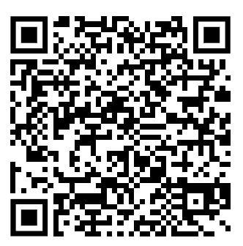
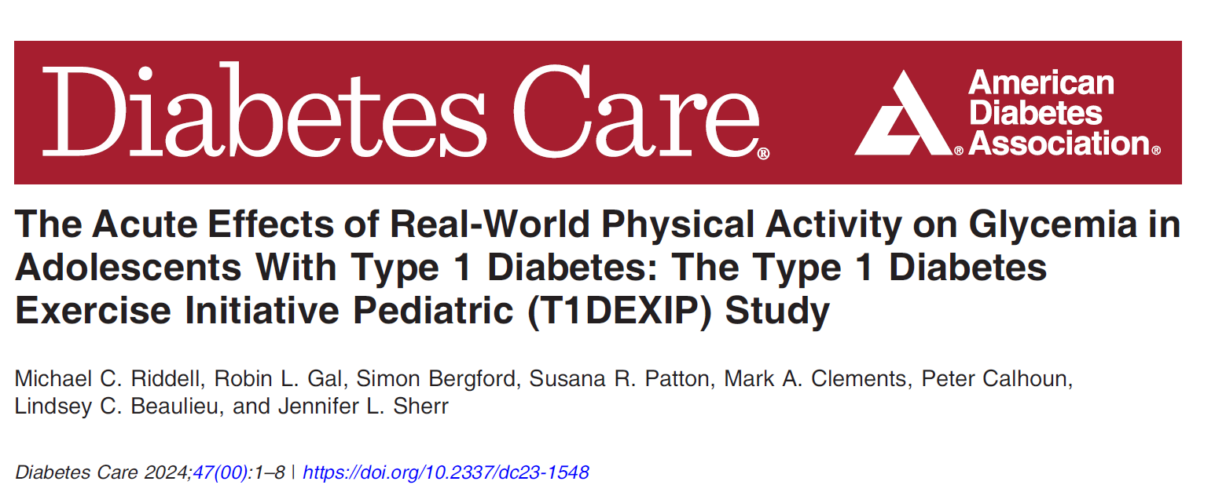
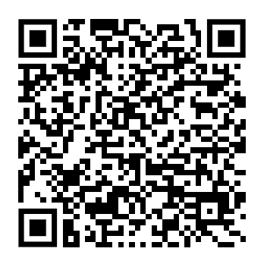
>8,000 sessions
>3,500 sessions
Notes:
Continuous glucose monitoring and activity data were collected from 404 adults (28-day observation free living activities and prescribed six 30-minute sessions of different activity types) - >8,000 exercise sessions
149 adolescents (10-day observation free living activites) with T1D.

Slide 17
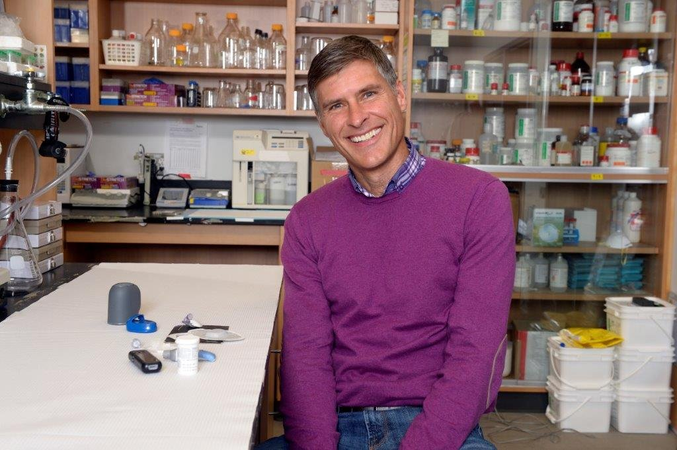
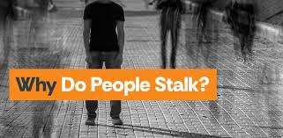
Sorry Mike

Slide 18
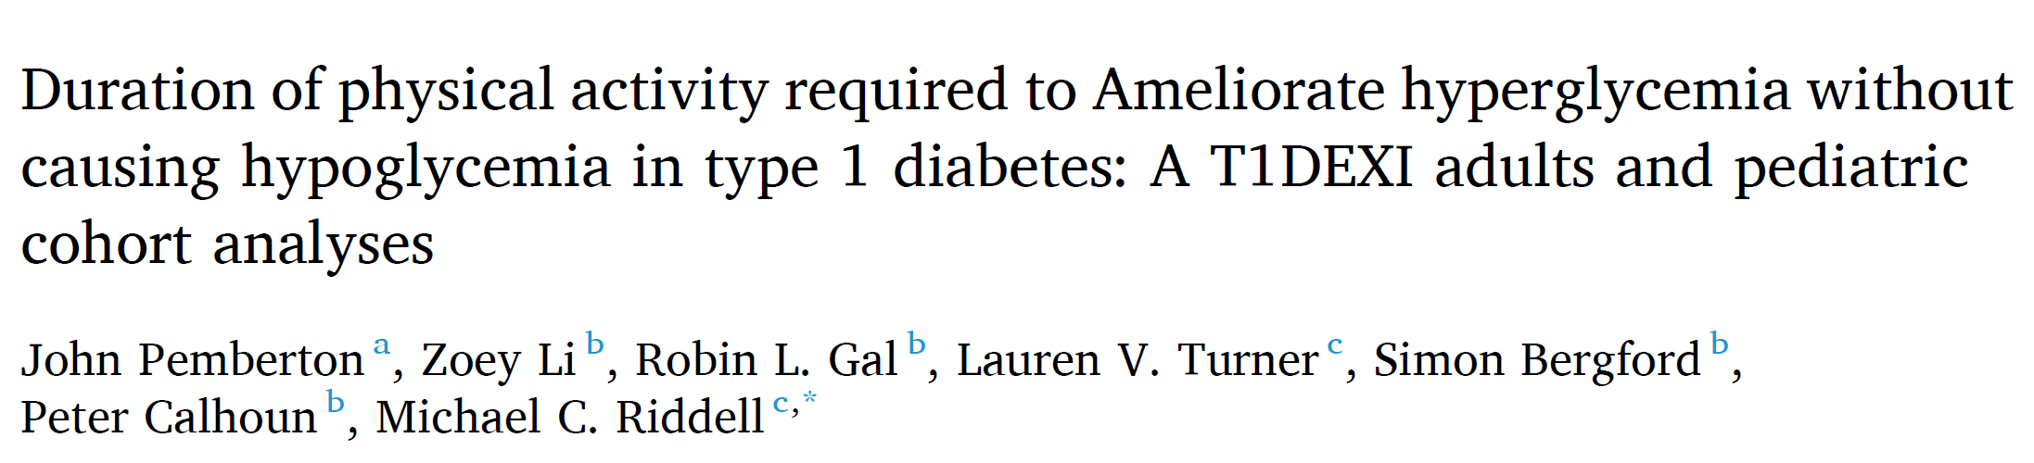
Aims:
Estimate activity duration to lower glucose from above target range (>180 mg/dL) to within target range (TIR: 70–180 mg/dL) in individuals with type 1 diabetes (T1D).
Methods:
404 adults and 149 adolescents with T1D.
Activities (N = 1902, Adults = 1599, Adolescent = 303)
Starting glucose between 181-300 mg/dL,
Duration 10–60 min with no reported meals during activity
N = 2,000
Result categories:
Starting glucose level (181–199, 200–224, 225–249, and 250–300 mg/dL)
Insulin on board (None, >0 to <0.04, ≥0.04 u/kg – four-hour linear decay model)
Rate of change (Falling: <-1 mg/dL/min, Stable -1 to 1 mg/dL/min, Rising >1 mg/dL/min)
Diabetes Research and Clinical Practice, Volume 220, 111981
Notes:
mg/dL) to within target range (TIR: 70–180 mg/dL) in individuals with type 1 diabetes (T1D).
Methods:
Continuous glucose monitoring and activity data were collected from 404 adults (28-day observation) and 149 adolescents (10-day observation) with T1D. Activities (N = 1902) with a starting glucose between 181- 300 mg/dL, duration 10–60 min, and no reported meals during activity were included in the analysis. Kaplan- Meier curves were used to estimate activity duration required to drop starting glucose levels from above to within TIR.
Results:
An overall starting glucose value of 181–199, 200–224, 225–249, and 250–300 mg/dL required an estimated activity duration of 15, 31, 59, and ≥ 60 min, respectively, to have a 50 % chance of reducing glucose to be within target range, with a 0–11 % incidence of hypoglycemia in the hour after activity. Activity duration requirements increased irrespective of starting glucose levels when glucose was trending upwards before activity and with zero bolus insulin on board at the start of activity. Adult and adolescent results were similar.
Conclusions:
Time-limited activity is an effective means of restoring TIR when hyperglycemia exists in adolescents and adults with T1D.

Slide 19
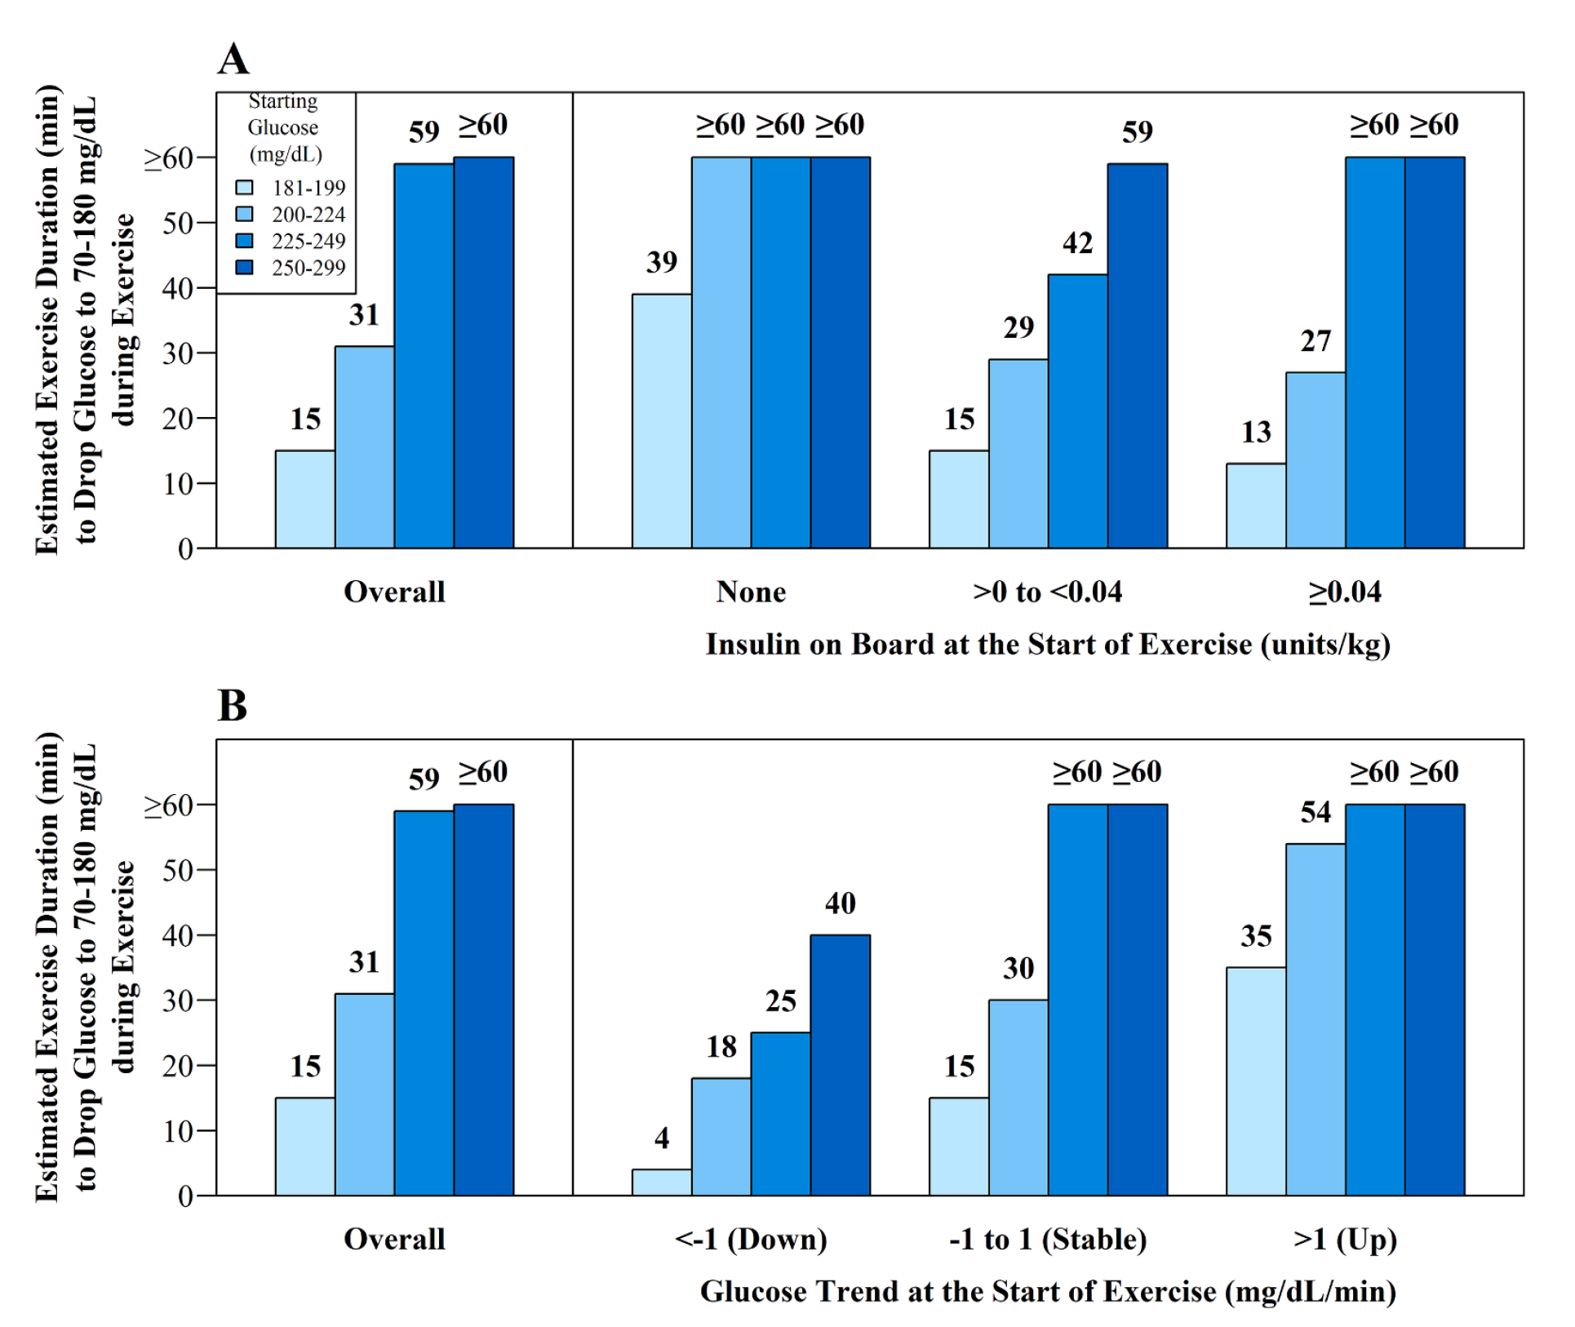
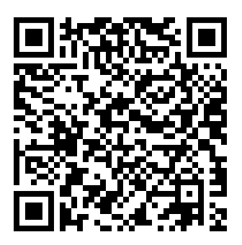

Diabetes Research and Clinical Practice, Volume 220, 111981
Notes:
mg/dL) to within target range (TIR: 70–180 mg/dL) in individuals with type 1 diabetes (T1D).
Methods:
Continuous glucose monitoring and activity data were collected from 404 adults (28-day observation) and 149 adolescents (10-day observation) with T1D. Activities (N = 1902) with a starting glucose between 181- 300 mg/dL, duration 10–60 min, and no reported meals during activity were included in the analysis. Kaplan- Meier curves were used to estimate activity duration required to drop starting glucose levels from above to within TIR.
Results:
An overall starting glucose value of 181–199, 200–224, 225–249, and 250–300 mg/dL required an estimated activity duration of 15, 31, 59, and ≥ 60 min, respectively, to have a 50 % chance of reducing glucose to be within target range, with a 0–11 % incidence of hypoglycemia in the hour after activity. Activity duration requirements increased irrespective of starting glucose levels when glucose was trending upwards before activity and with zero bolus insulin on board at the start of activity. Adult and adolescent results were similar.
Conclusions:
Time-limited activity is an effective means of restoring TIR when hyperglycemia exists in adolescents and adults with T1D.

Slide 20
Other key findings
No differences by:
Therapy type (49% HCL, 35% CSII, 16% MDI)
Age (Adults vs Adolescent)
Activity type (Aerobic, Interval, Resistance)
Longer duration required for female adults starting between 225-249 mg/dL
0-11% risk of hypoglycaemia overall, up to 30 minutes a maximum 7% risk with fast falling ROC
Chance of glucose increasing during activity
>0 units/kg insulin on board: 11-31%
Zero insulin on board: up to 54%
Diabetes Research and Clinical Practice, Volume 220, 111981
Notes:
mg/dL) to within target range (TIR: 70–180 mg/dL) in individuals with type 1 diabetes (T1D).
Methods:
Continuous glucose monitoring and activity data were collected from 404 adults (28-day observation) and 149 adolescents (10-day observation) with T1D. Activities (N = 1902) with a starting glucose between 181- 300 mg/dL, duration 10–60 min, and no reported meals during activity were included in the analysis. Kaplan- Meier curves were used to estimate activity duration required to drop starting glucose levels from above to within TIR.
Results:
An overall starting glucose value of 181–199, 200–224, 225–249, and 250–300 mg/dL required an estimated activity duration of 15, 31, 59, and ≥ 60 min, respectively, to have a 50 % chance of reducing glucose to be within target range, with a 0–11 % incidence of hypoglycemia in the hour after activity. Activity duration requirements increased irrespective of starting glucose levels when glucose was trending upwards before activity and with zero bolus insulin on board at the start of activity. Adult and adolescent results were similar.
Conclusions:
Time-limited activity is an effective means of restoring TIR when hyperglycemia exists in adolescents and adults with T1D.

Slide 21
Key take home messages
10–30 minutes of activity effective when 181 to 249 mg/dL (10.0-13.9 mmol/L)
Low risk of hypoglycaemia.
If bolus insulin within 4 hours
For glucose levels above 250 mg/dL (13.9 mmol/L), check for ketones:
If ketones >0.6 mmol/L, only use insulin to correct
If ketones <0.6 mmol/L, provide a 50% correction before physical activity.
This strategy should be used at the discretion of the individual with type 1 diabetes,
Would the glucose have dropped without the activity?

Slide 22
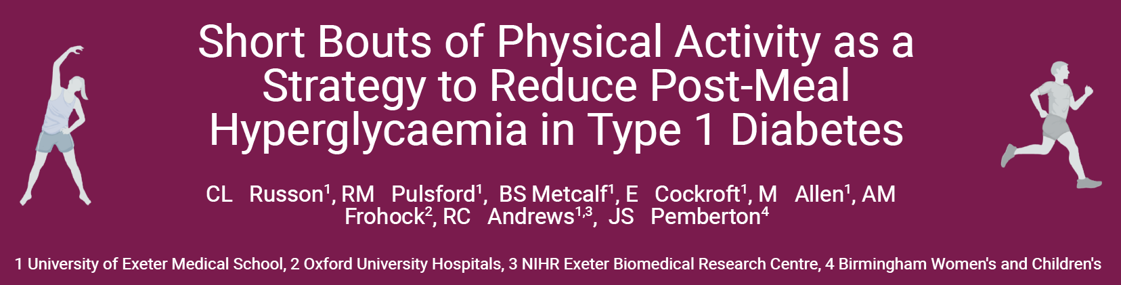
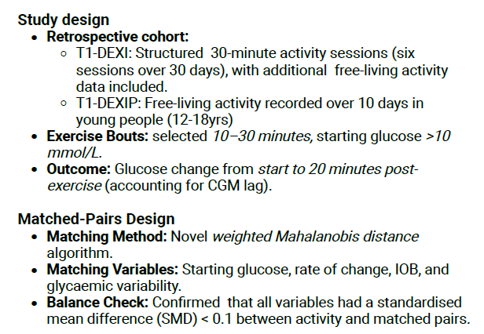
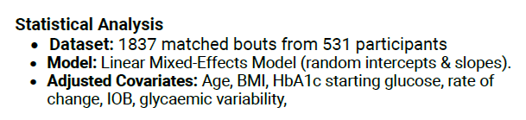
SMD <0.1 is needed and our model was <0.01?
Pretend I am stupid…

Slide 23
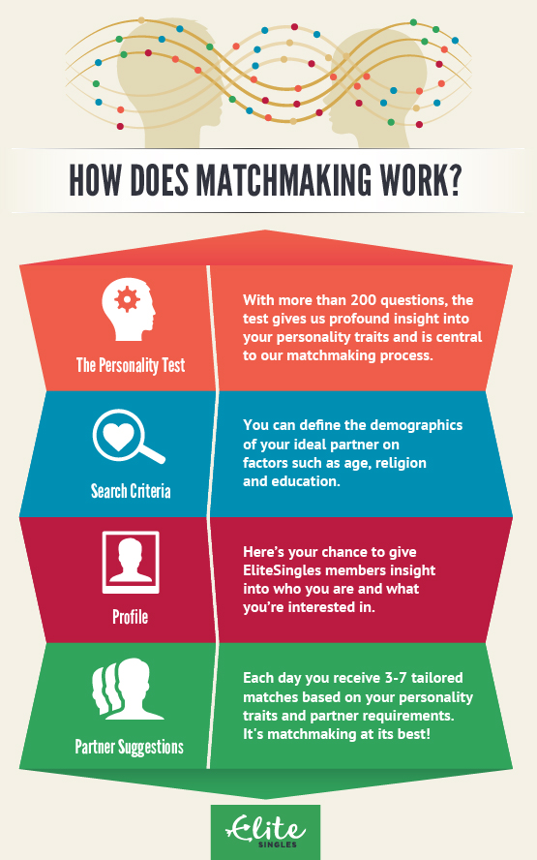


Slide 24
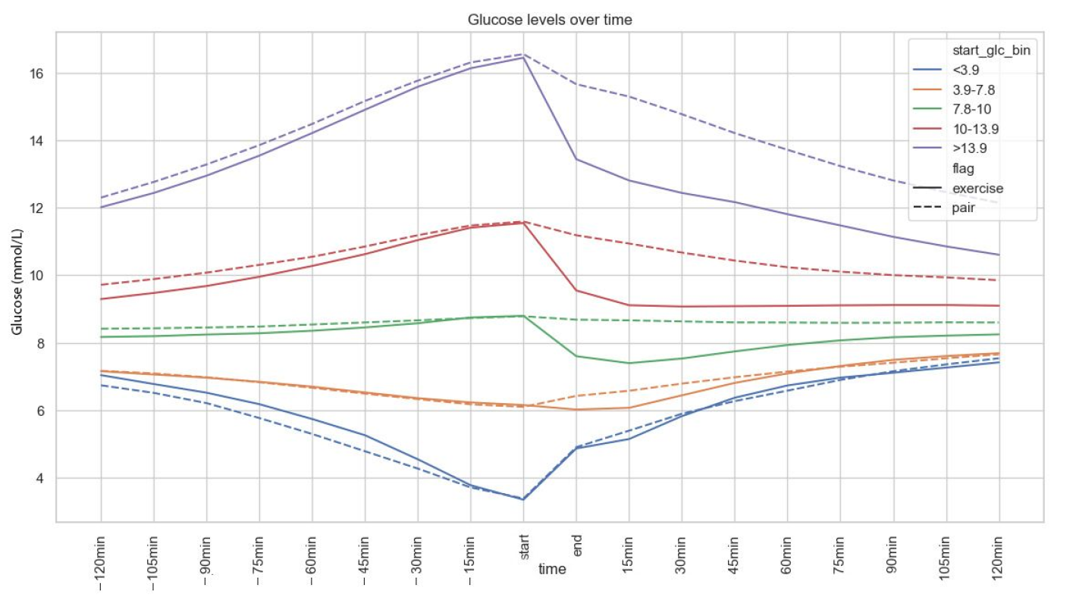
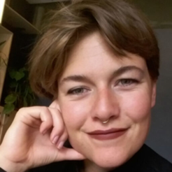
On average: for 20 mins after activity
non-activity vs 20 mins of activity
0.6 mmol/L vs 2.4 mmol/L in 20 mins
11 mg/dL vs 44 mg/dL is 20 mins

Slide 25
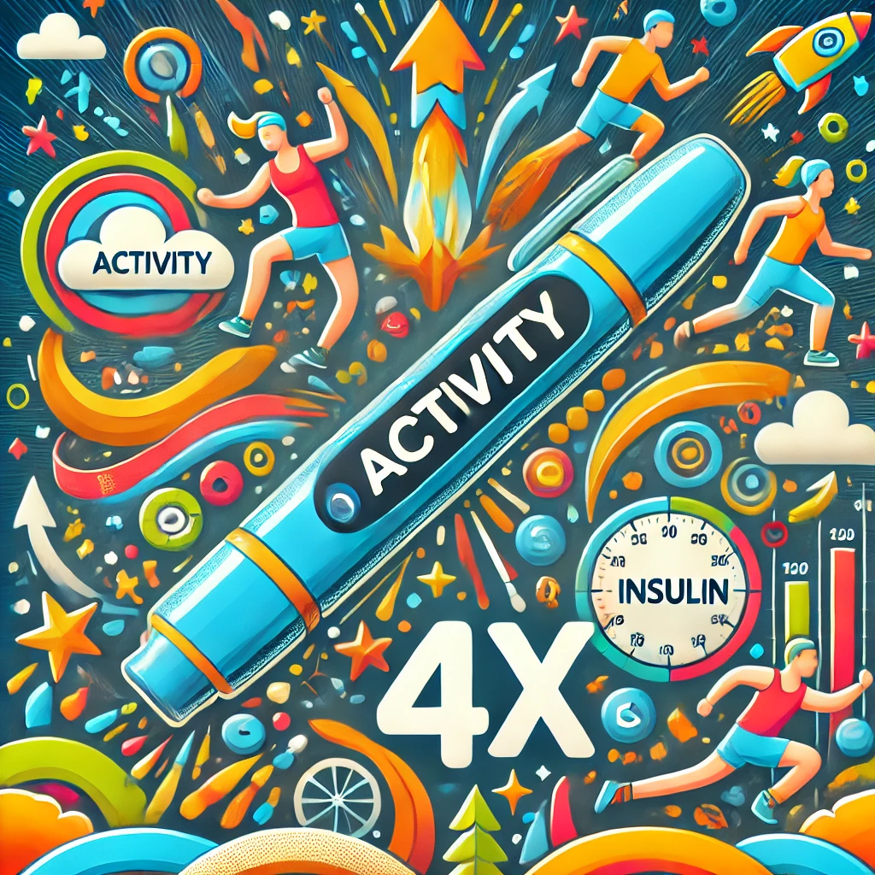

Slide 26
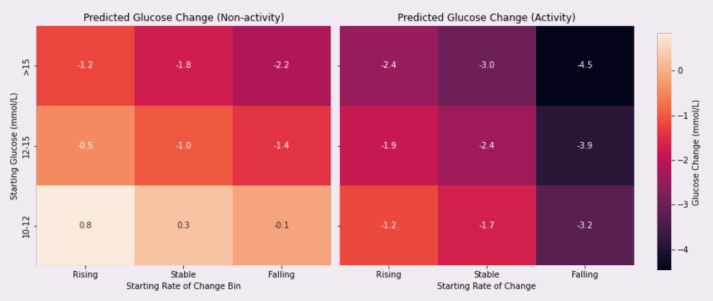

Slide 27
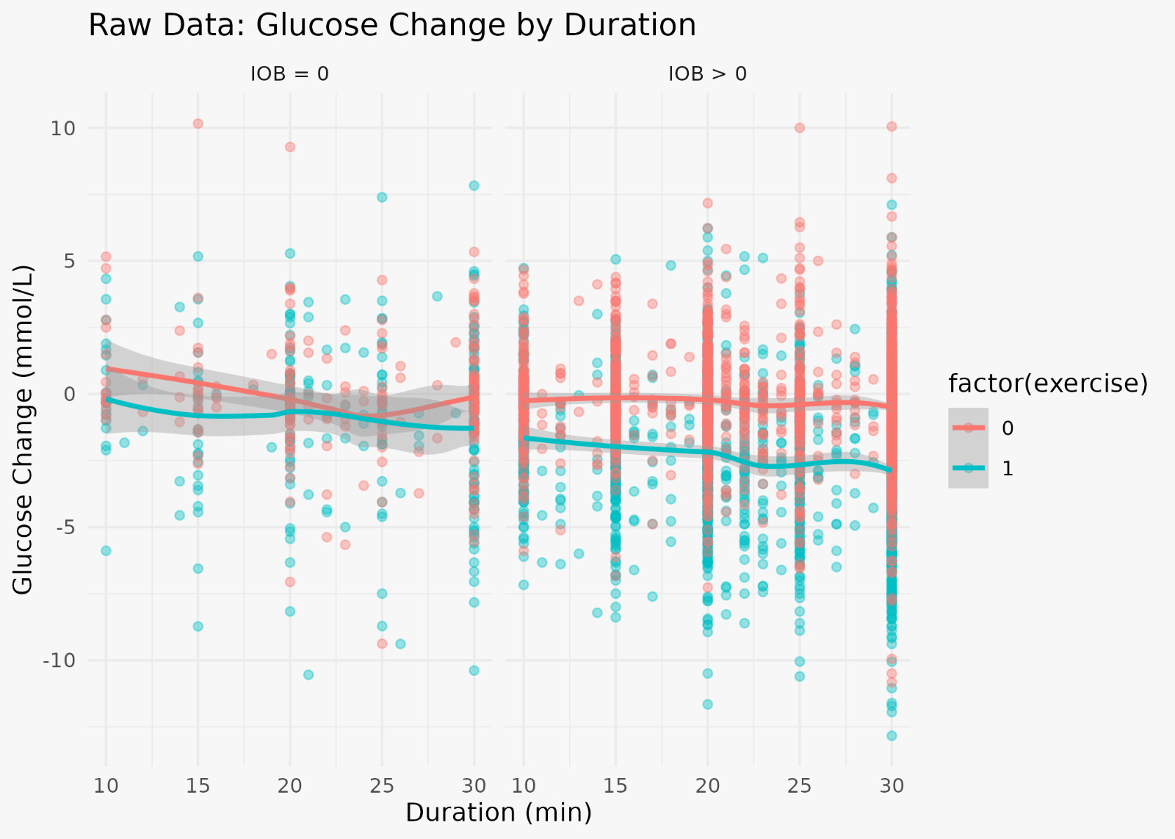

Bolus insulin within
4 hours for hours

Slide 28
What about
2-hour area under the curve reductions?

Slide 29



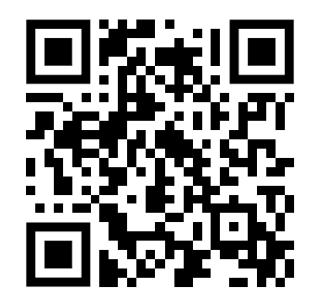
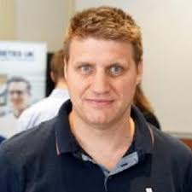
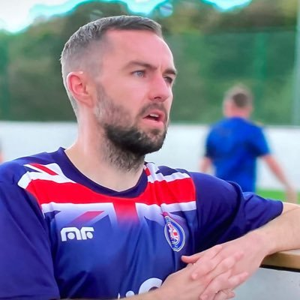


Dr. Dessi P Zaharieva
Prof Rob Andrews
Chris Bright

Slide 30
Summary
3 every 30: 3-minute activity snacks throughout the day to optimise time in range
(3.9-10.0 mmol/L or 70-180 mg/dL)
Before meals: 20 minutes walking to sensitise the body to insulin
After-meals: 15-30 mins walking to stay in range (tight range)
15 by 2 or 15 by 40: After-meals: >10.0 mmol/L (180 mg/dL):
Activity Supercharges Bolus Insulin by 4X

Slide 31



Acknowledgements
North American Team:
Zoey Li
Robin L. Gal
Lauren V. Turner
Simon Bergford
Peter Calhoun
Michael C. Riddell
The UK Team:
Cat Russon
Richard Pulsford
Brad Metcalf
Emma Cockcroft
Michael Allen
Anne-Marie Frohock
Rob Andrews

Slide 32
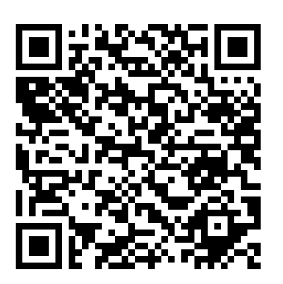


99 Problems
But High Glucose Aint One
Podcast
Activity Snacking to increase TIR
Download 99 Problems …
Resources
Click on the link for
“Google Drive”
johnpemberton@nhs.net
OpenAI. (2025). ChatGPT. https://chat.openai.com/chat

